Slide 1
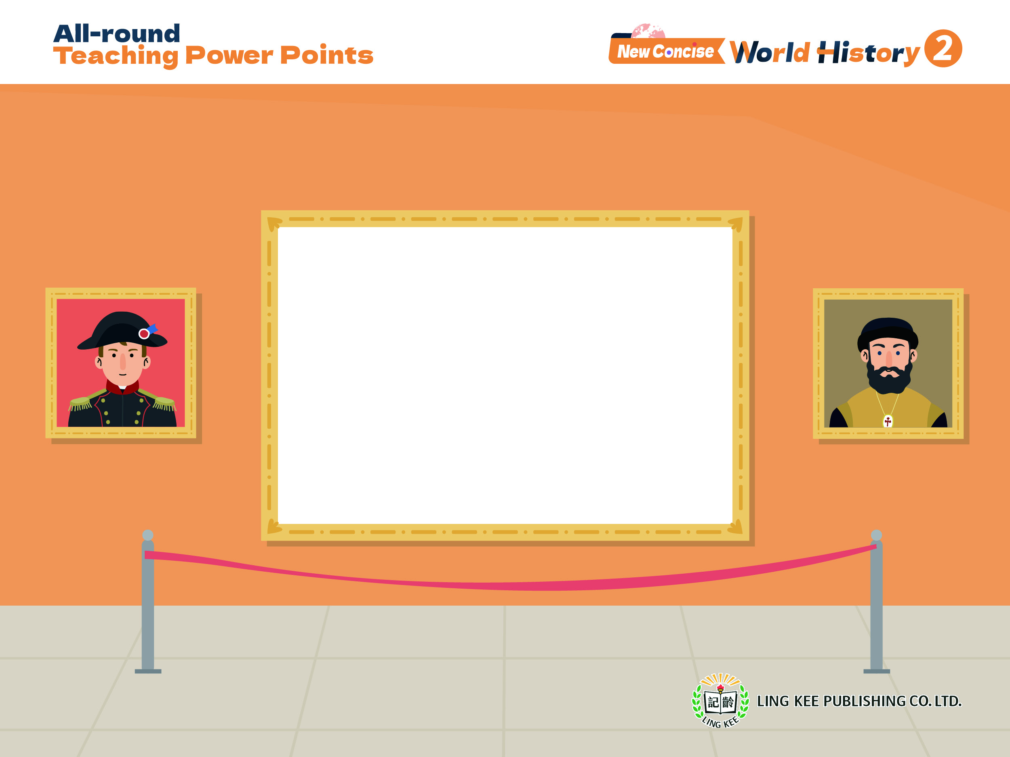
Topic 5 Rise of modern Europe
I From God-centred to human-centred: the Renaissance and the Reformation
Renaissance (1)
2A, pp.6-10

Slide 2

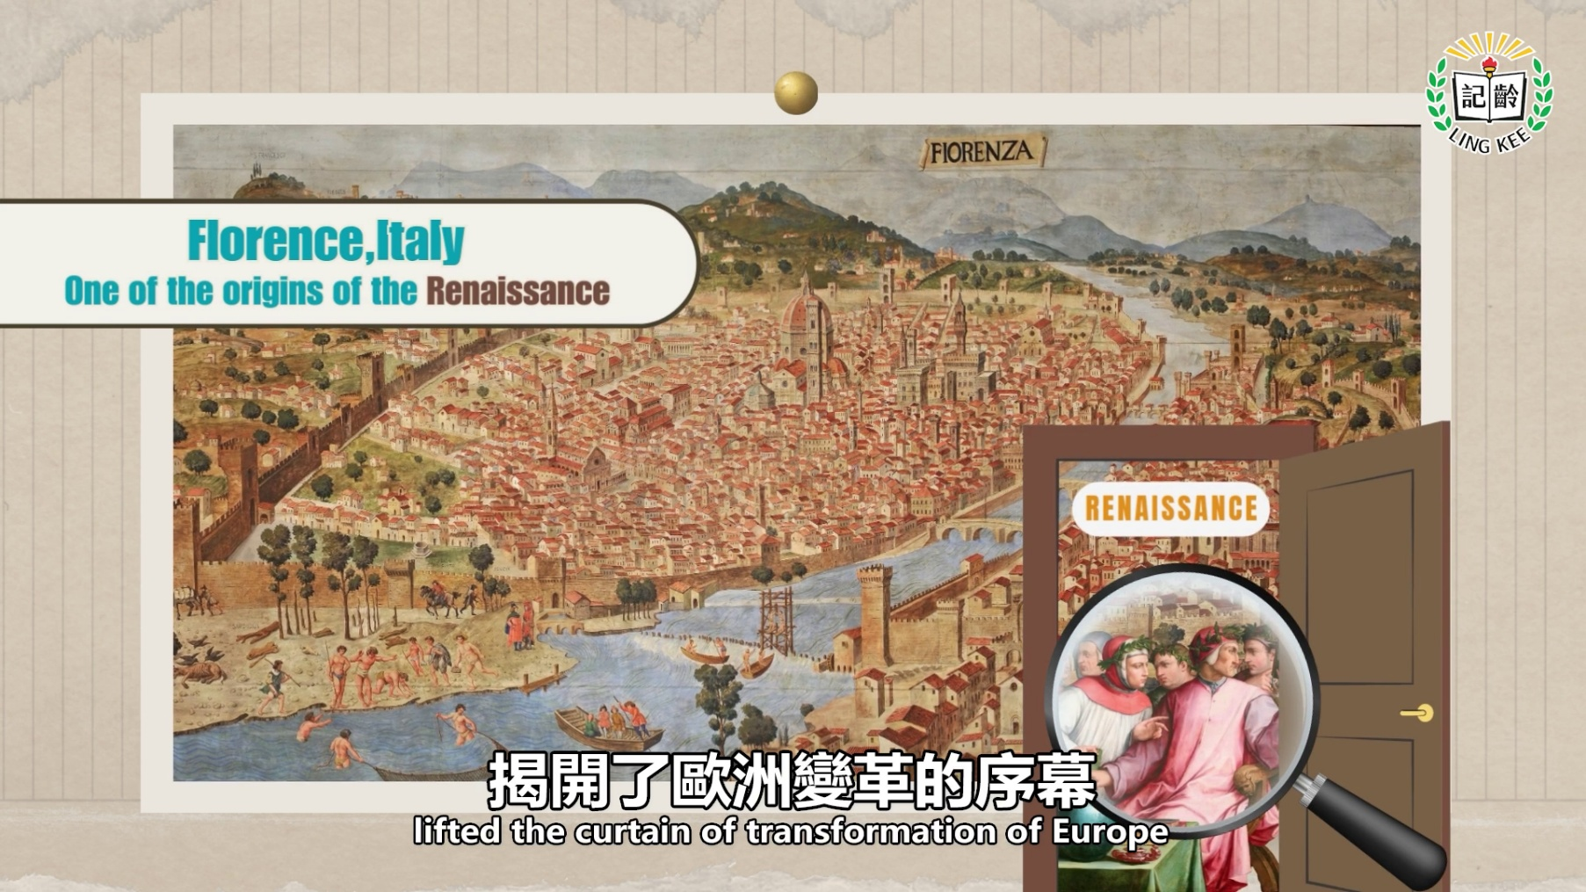

Topic 5
2A pp.6-99

Slide 3
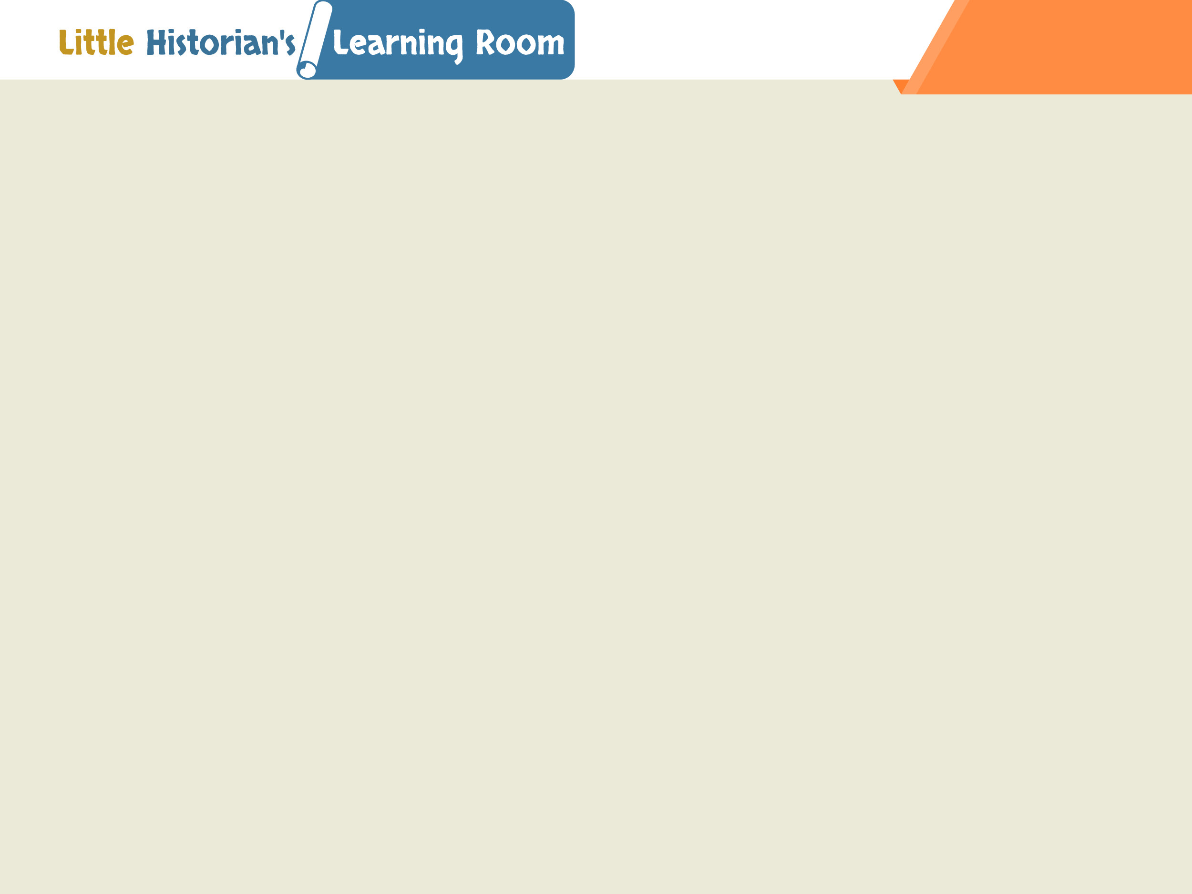
2A p.4
How to interpret paintings?
Through observing the existing paintings, we can learn about how people in the past lived and thought.
Details to notice
 | Examples
Words | Titles, source introduction, conversations between figures
Figures | Age, gender, clothing, actions
Time | The time when the painting was created, the period related to the theme of the painting
Location | The place where the event in the painting took place
Objects | Buildings, food, tools, decorations

Slide 4
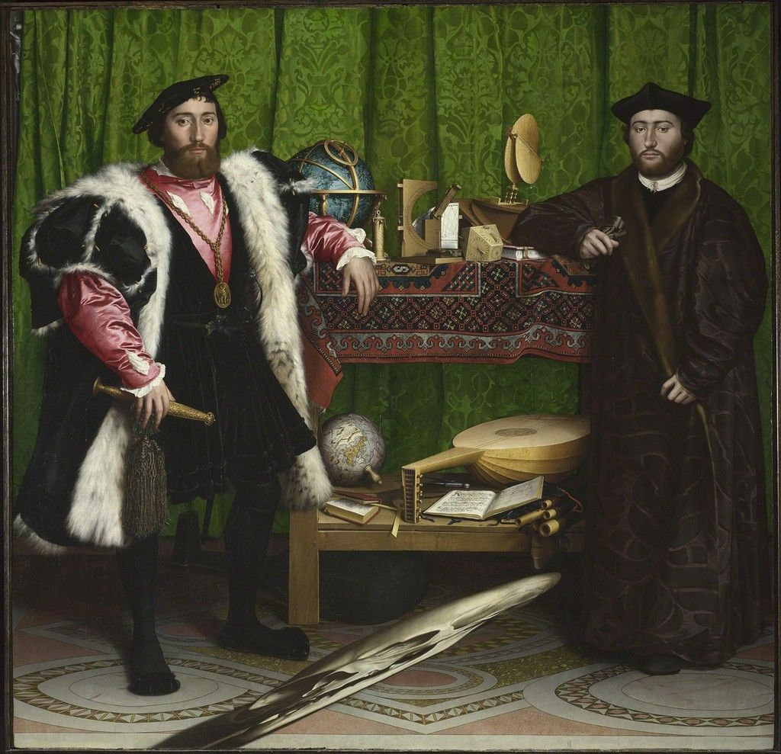
2A p.4
Time: Specific year that the painting was completed
Painting entitled The Ambassador (使節) by the German painter Hans Holbein (霍爾班) in 1533
Words: Source introduction
showing the painter, publishing year and theme of the painting

Slide 5
2A p.4
Figures: A scholar meeting with an ambassador
Objects: Various scientific instruments, a globe, books, etc. on the table
Painting entitled The Ambassador (使節) by the German painter Hans Holbein (霍爾班) in 1533

Slide 6

2A p.4
It is worth noting that content of the painting might include the painter's personal views towards historical events or figures. These views might not be objective historical facts.
Which of the following descriptions about the painting above are correct? (Put ✔)
It was painted in the 14th century.
The painter was from Britain.
A telescope (望遠鏡) can be seen in the painting.
Europeans had already recognised that Earth had a roughly spherical shape when the above painting was created.

Slide 7
2A p.5
How to interpret data?
Data are presented in different graphs, such as histogram (直線圖), bar chart (棒形圖), line chart (折線圖), pie chart (圓形圖), etc.
When reading a data graph, we need to pay attention to the title and co-ordinates first to understand the theme and content.
Then, we need to focus on the changes and trends of data.
Line Chart

Slide 8
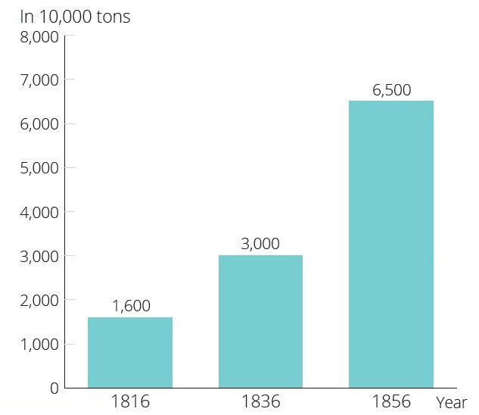
2A p.5
Annual coal production of Britain during 1816 - 1856
Title:
Showing the theme, related period, location, people, etc.
of the data graph

Slide 9
2A p.5
Annual coal production of Britain during 1816 - 1856
Data:
Analysing data from various angles, paying attention to the most significant information (like the largest and smallest ones), changes and trends of data and relationship between the two axes

Slide 10
2A p.5
Annual coal production of Britain during 1816 - 1856
Co-ordinates:
Showing the
units, usually on
the horizontal
axis and the
vertical axis

Slide 11

2A p.5
Answering tips
Paying attention to the time period mentioned in the question
Paying attention to the data that the question requires to respond to
Citing data when answering
Frequently used wordings for trends
Rise / Increase
Decline / Decrease
Stay unchanged
From _______ to _________
Continuously / Constantly

Slide 12
2A p.5
1. Coal production of which country is the above graph related to?
2. How much coal did that country produce in 1816?
Britain
16 million tons

Slide 13
2A p.5
3. Identify the trend of annual coal production of that country during 1816-1856.
In ______________ , the annual coal production of___________ continuously __________ 。
1816-1856
Britain
rose

Slide 14

Topic 5
2A p.6
How did the Renaissance lead to the rise of humanism?

Slide 15
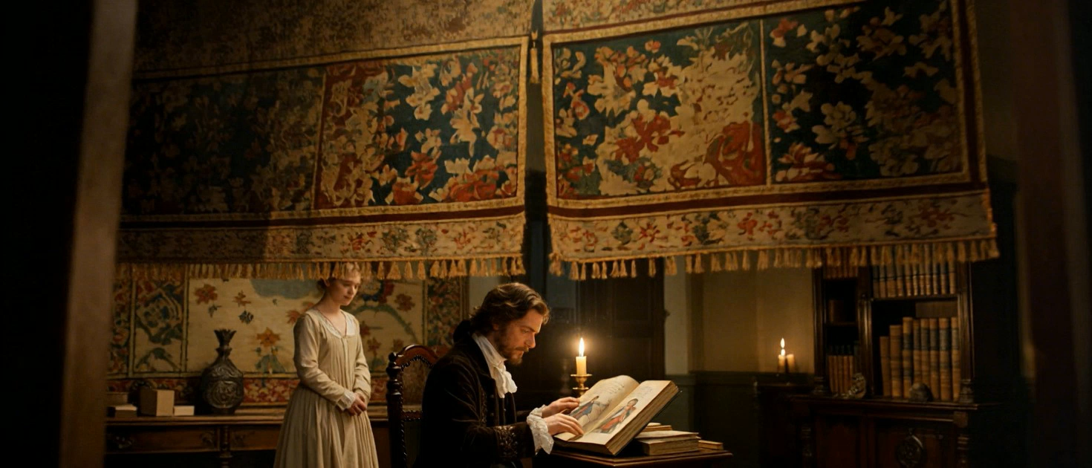

Topic 5
2A p.6
Between the 14th and 17th centuries, a cultural movement called the Renaissance took place in Europe.
This movement first started in various cities of Italy, then it spread to other countries in Europe.

Slide 16
Topic 5
2A p.6
originally means:
‘recovery’ or ‘rebirth’
The revival of ancient Greek and ancient Roman civilisations
Reinvented classical civilisation
Renaissance
Europe underwent a gradual transition to early modern times.

Slide 17

i. Background of the
Renaissance
2A pp. 6-7

Slide 18
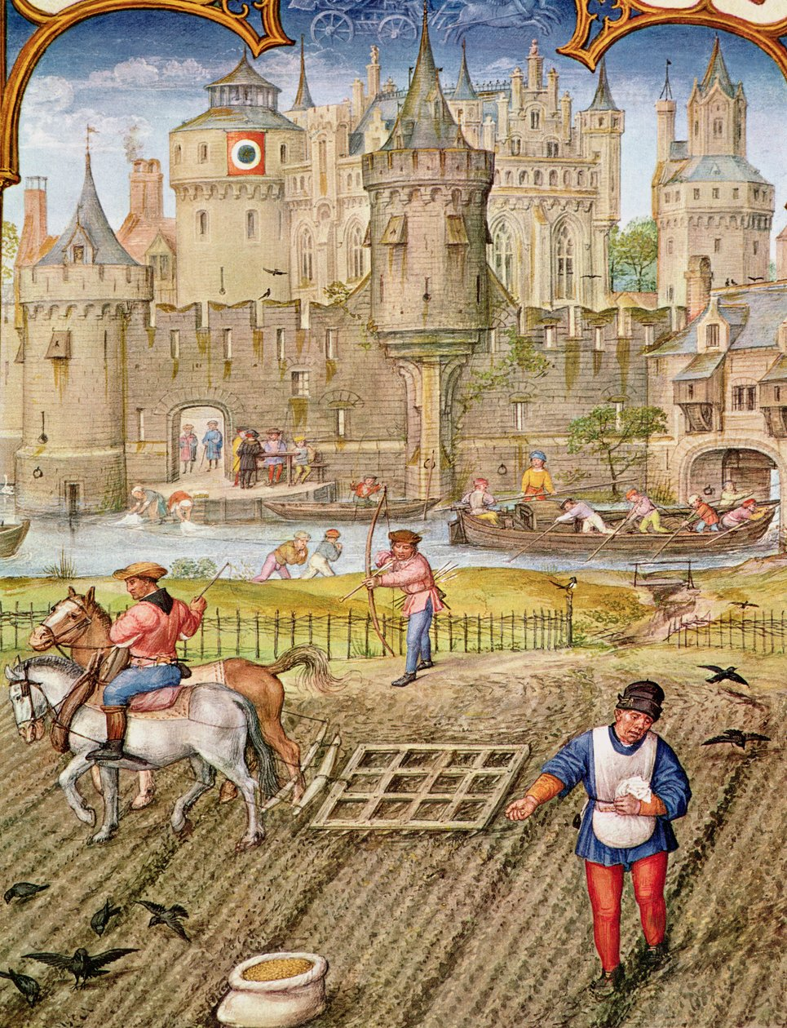
Topic 5
2A p.6
In the late Medieval Times, the feudal society in Europe started to decline.
The influence of the Church on countries' politics, economies and education grew weaker.
A painting showing the life in a manor in European Feudal Society

Slide 19
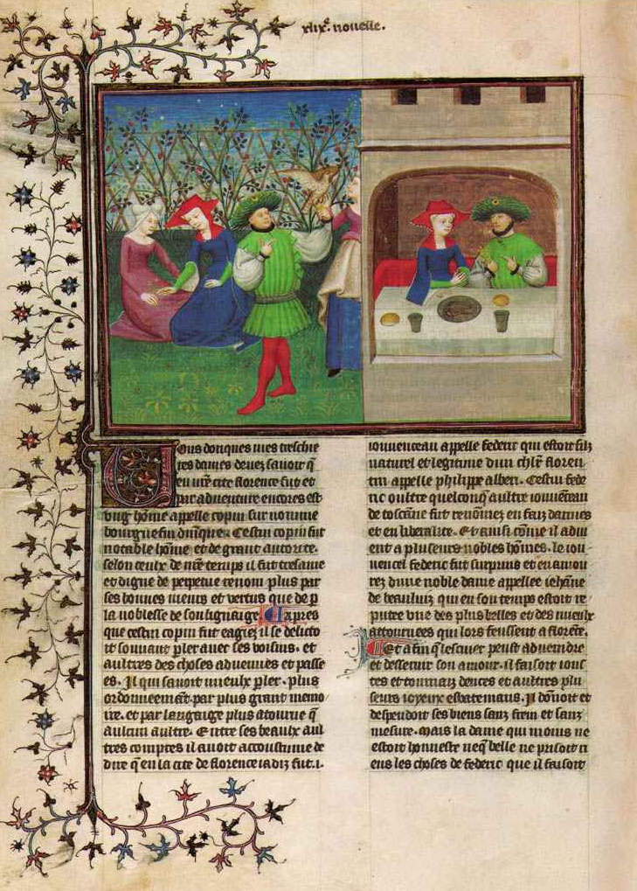
Topic 5
2A p.6
Many serfs fled from manors to autonomous cities.
Many universities had rose. People began to study practical science.
Decameron, a literary classic from the Renaissance

Slide 20
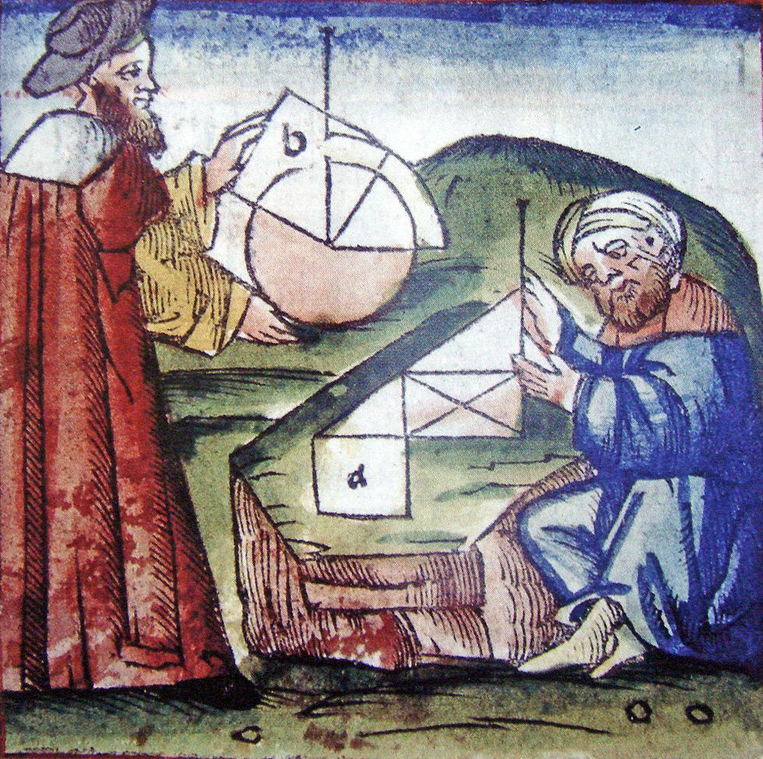
Topic 5
2A p.6
Islamic civilisation gradually spread in Europe, bringing along new knowledge in astronomy and medicine.
This also helped to lead to the Renaissance.
Painting showing the exchanges between medieval European and Muslim mathematicians.

Slide 21
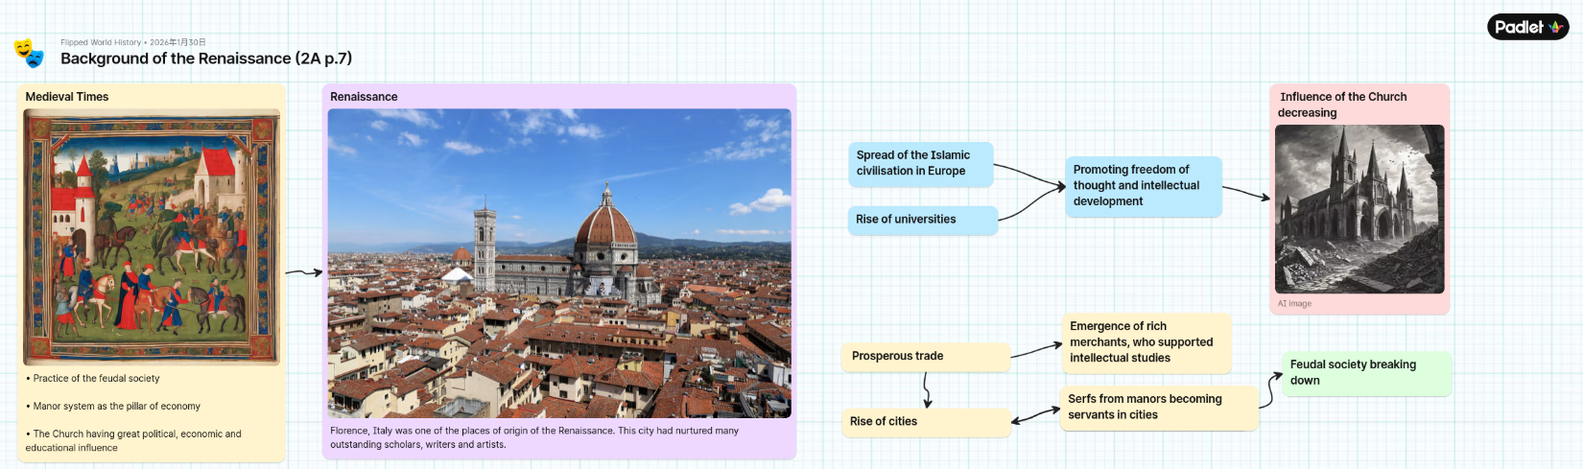

Topic 5
2A p.7
Background of the Renaissance

Slide 22
ii. Reasons for Italy being the birthplace of the
Renaissance
2A pp.8-10

Slide 23
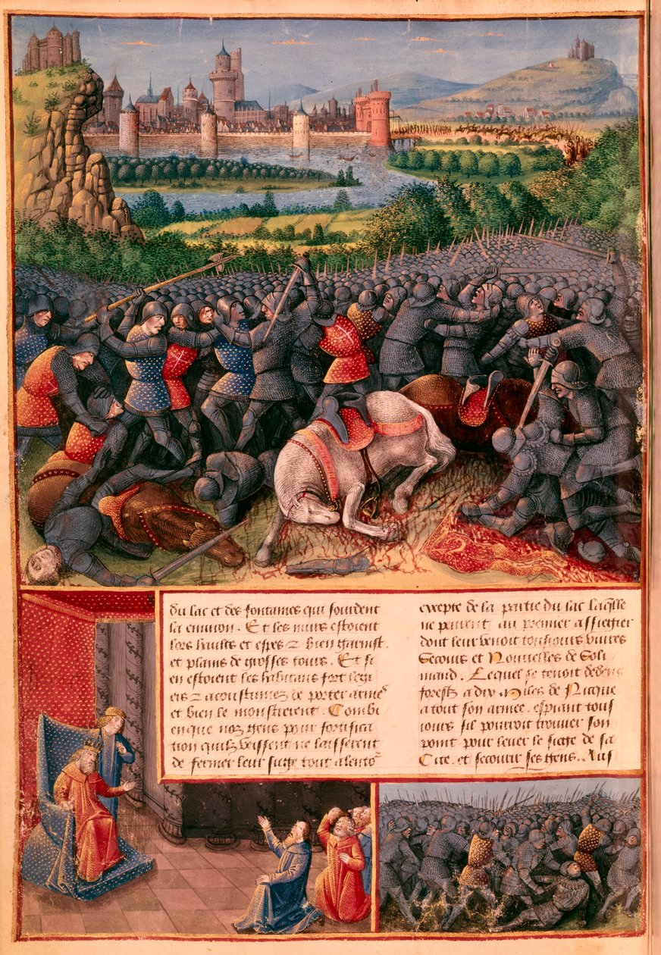
課題5
2上，頁8
Prosperous overseas trade
Between the 11th and 13th centuries, European countries undertook a series of Crusades to West Asia and North Africa.
The Crusades greatly enhanced the development of trade between the East and the West.
A painting showing the Crusades

Slide 24
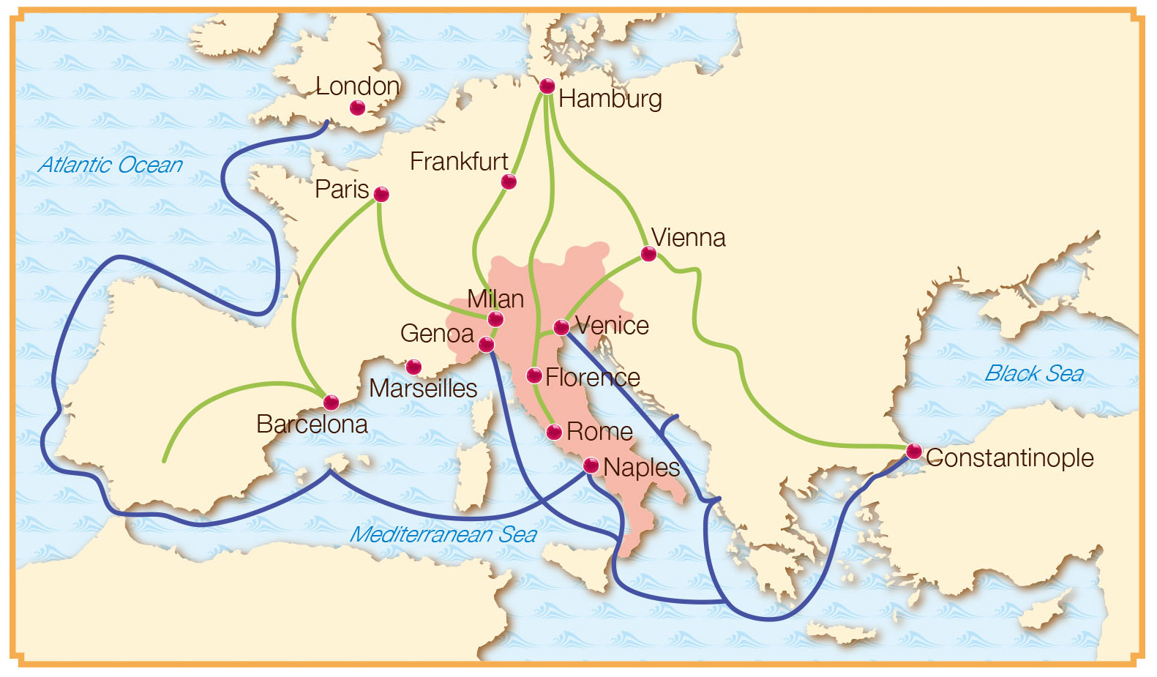
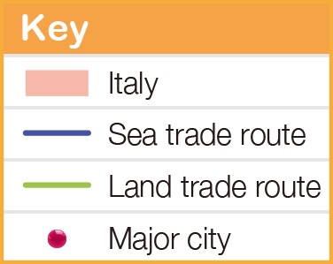


Topic 5
2A p.8
As Italy was located in the centre of Europe, many Italian cities, such as Venice, Genoa and Florence, flourished in commerce.
Italian trade routes in the 14th century

Slide 25

Topic 5
2A p.8
According to the map, how did Italy become the middleman of trade between the East and the West?
Italy was located in the centre of ( Europe / Asia ). It could reach ( Constantinople / London ) by travelling eastward as well as the major cities of Western and Central Europe by travelling westward. On the other hand, as Italy was located in the centre of the ( Mediterranean Sea / Black Sea ), merchants could sail to North Africa from there.

Slide 26
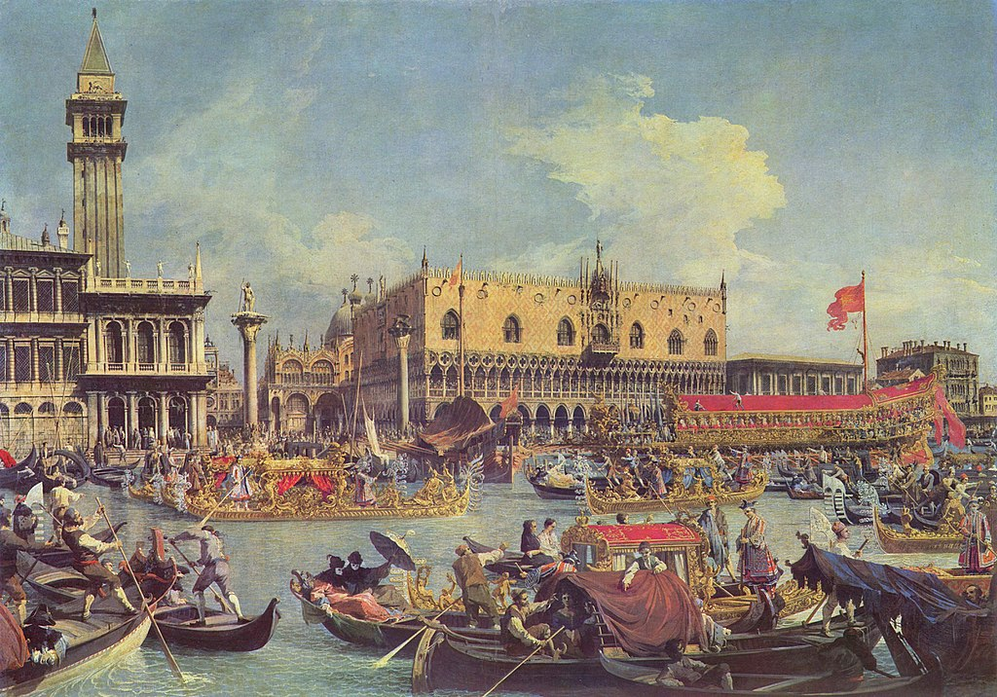
Topic 5
2A p.8
The wealthy economic environment provided an ideal condition for intellectual studies as well as art creations.
A painting showing the prosperity of a port in Venice at that time

Slide 27
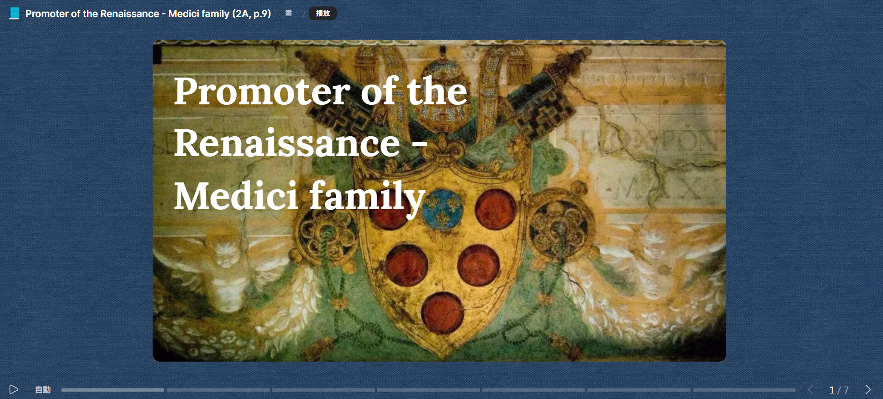
Topic 5
2A p.9
2 Funds from rich merchants
Many rich Italian merchants spent large sums of money to sponsor cultural and scientific development.
Most famous among them was the Medici family in Florence.
Promoter of the Renaissance - Medici family

Slide 28
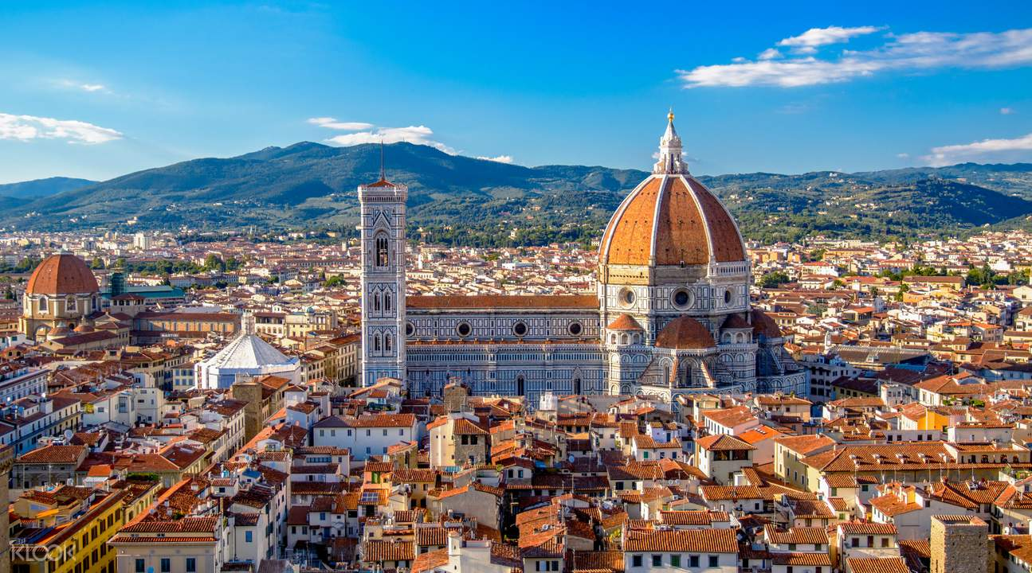
Topic 5
Today’s Florence
2A p.9
With their support, Florence at one point became the centre of the Renaissance in Italy.

Slide 29
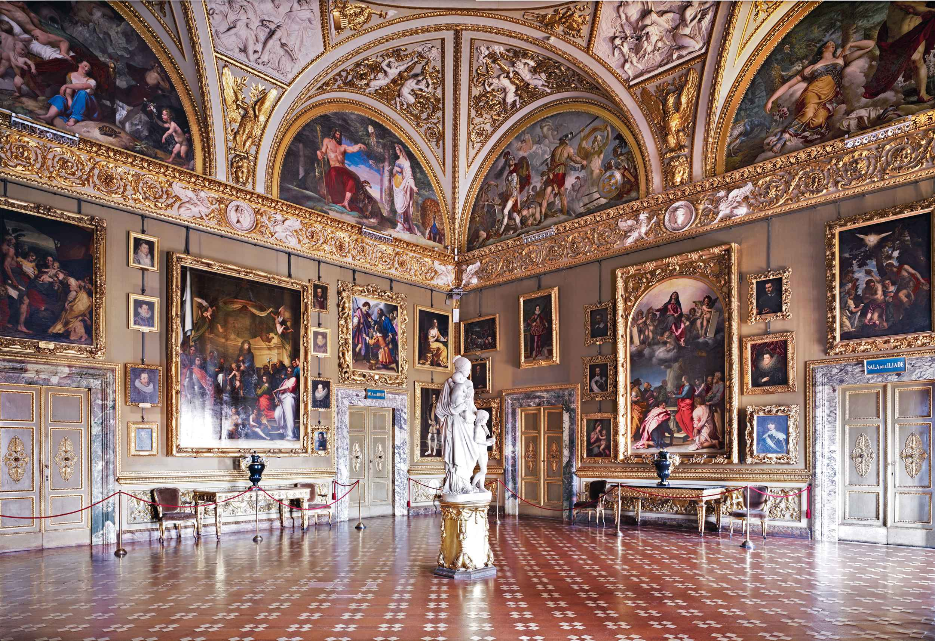
Topic 5
2A p.9
The Pitti Palace of the Medici family
1
What kind of life did the Medici family lead, as depicted in the pictures?
They loved art and pursued a high-quality life.

Slide 30
Topic 5
2A p.9
The Pitti Palace of the Medici family
2
Infer how their lives contributed to the development of the Renaissance.
They sponsored cultural activities and encouraged the artistic creation.

Slide 31
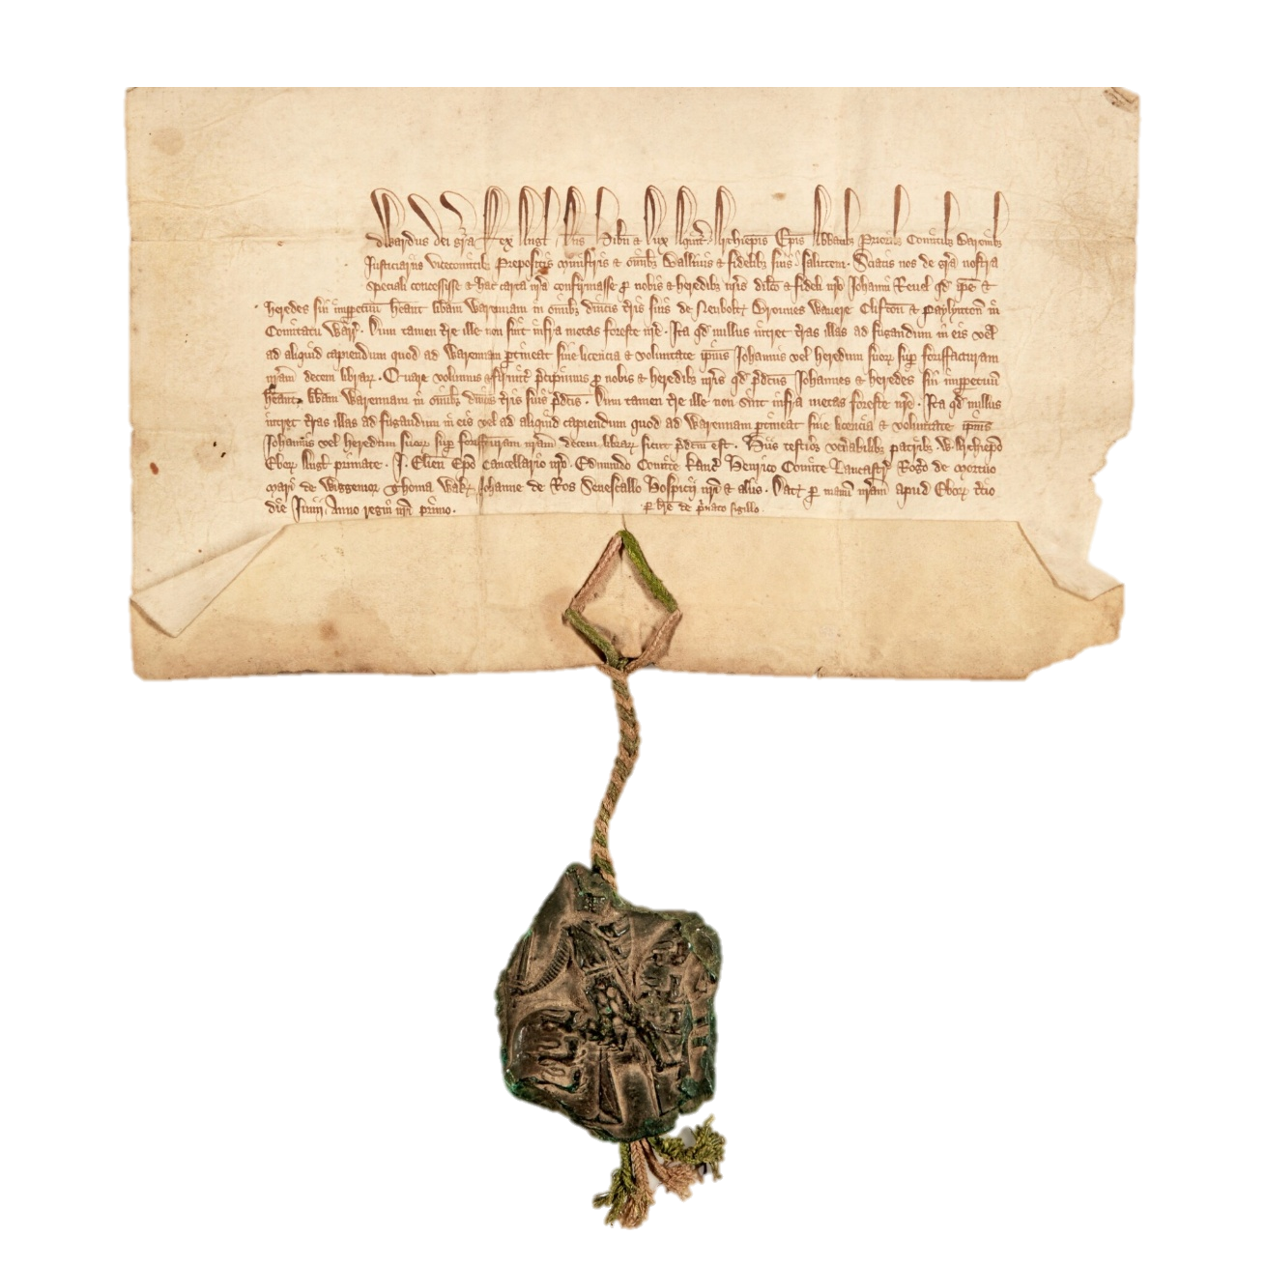
Topic 5
2A p.10
3 Autonomy of cities
In the late Medieval Times, rich Italian merchants paid the feudal lords to get charters of autonomy for their cities.
In the Medieval Times, the bourgeoisie paid lords for charters in exchange for autonomy over their cities.

Slide 32
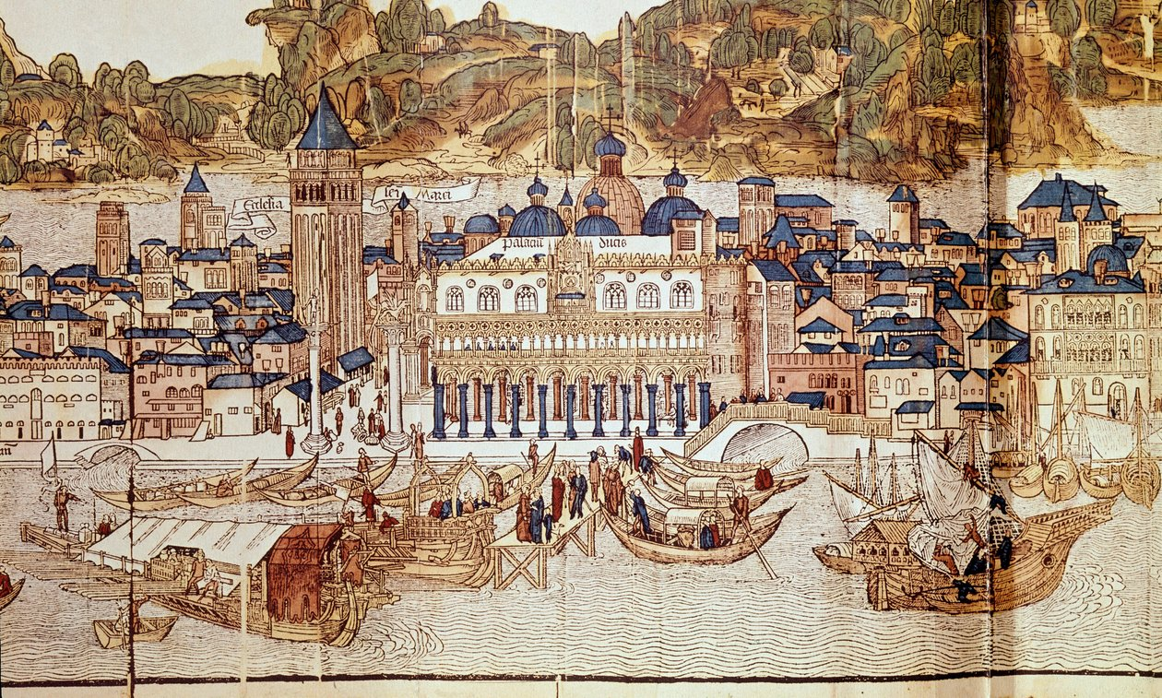
Topic 5
2A p.10
Therefore, the Italian people were less restricted in their thinking. They had more freedom and were more open to new ideas.
Painting showing the 15th-century Venice

Slide 33
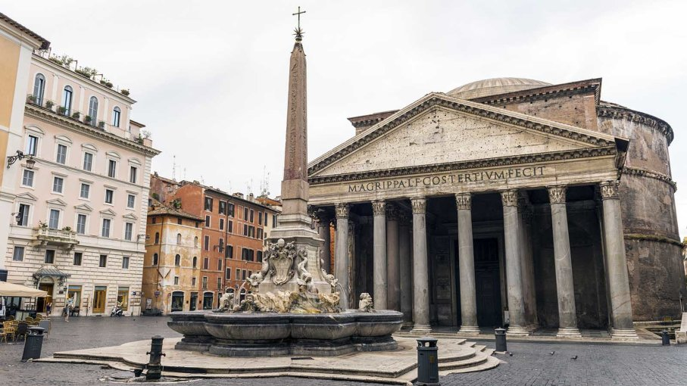
Topic 5
2A p.10
4 Cultural heritage of classical civilisation
Italy was the successor to ancient Greek and ancient Roman civilisations.
It had many historical sites and artifacts.
The Pantheon in Rome in Italy

Slide 34
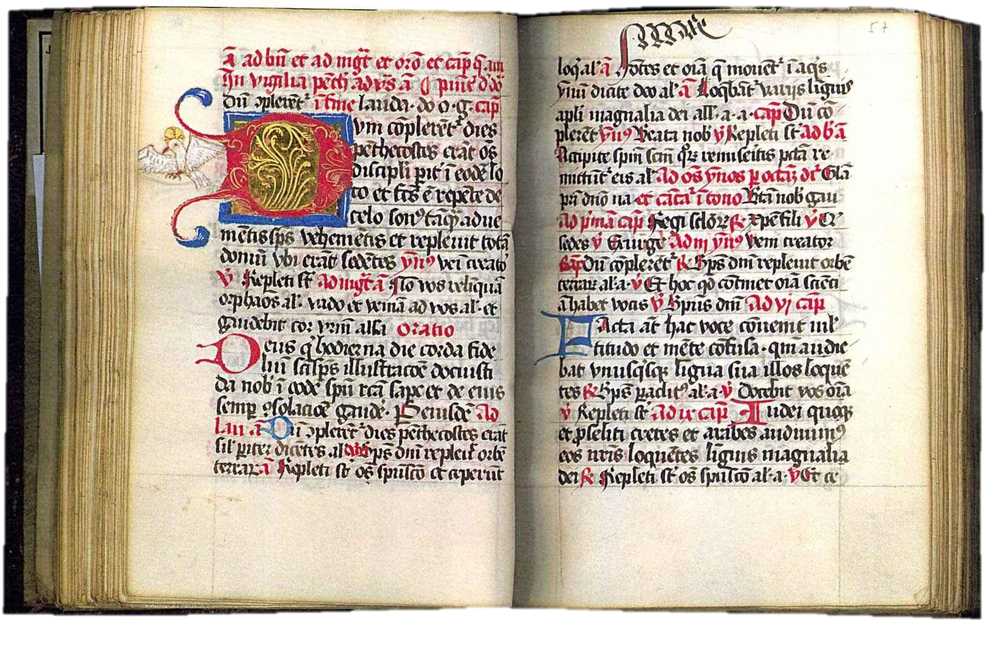
Topic 5
2A p.10
After the fall of the Eastern Roman Empire in 1453, a lot of scholars fled to Italy.
They brought along with them many Greek and Latin books. This gave rise to the trend of studying classical civilisation.
Medieval Latin Classics

Slide 35
Topic 5
2A p.10
In your opinion, how was Italy attractive to scholars during the Renaissance?
Italian cities were wealthy and could support the development of the arts. / The Medici family, a wealthy local merchant family, actively supported the arts. / Italians possessed a rich cultural heritage that contributed to academic research. (Choose one)

Slide 36

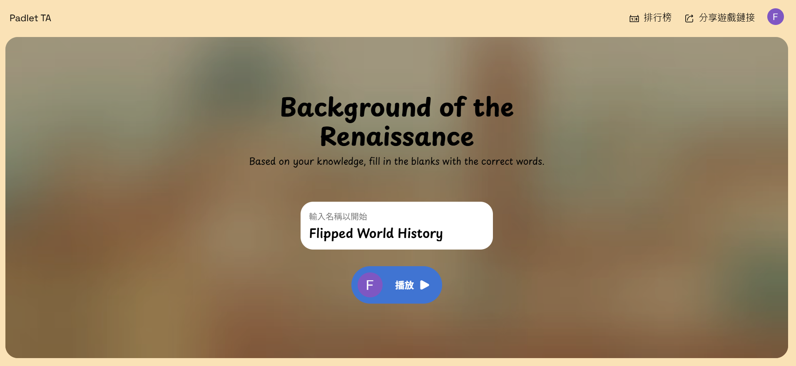

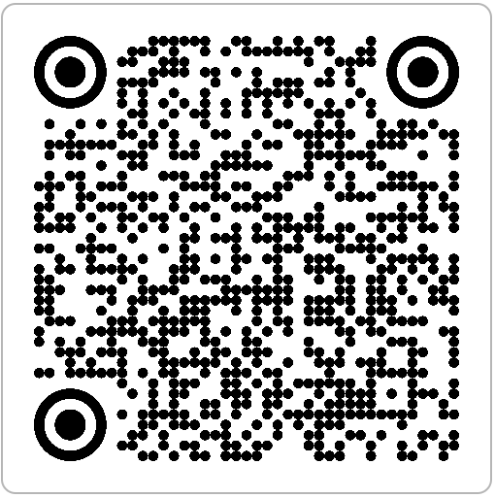
Topic 5
2A pp.4-10

