Slide 1
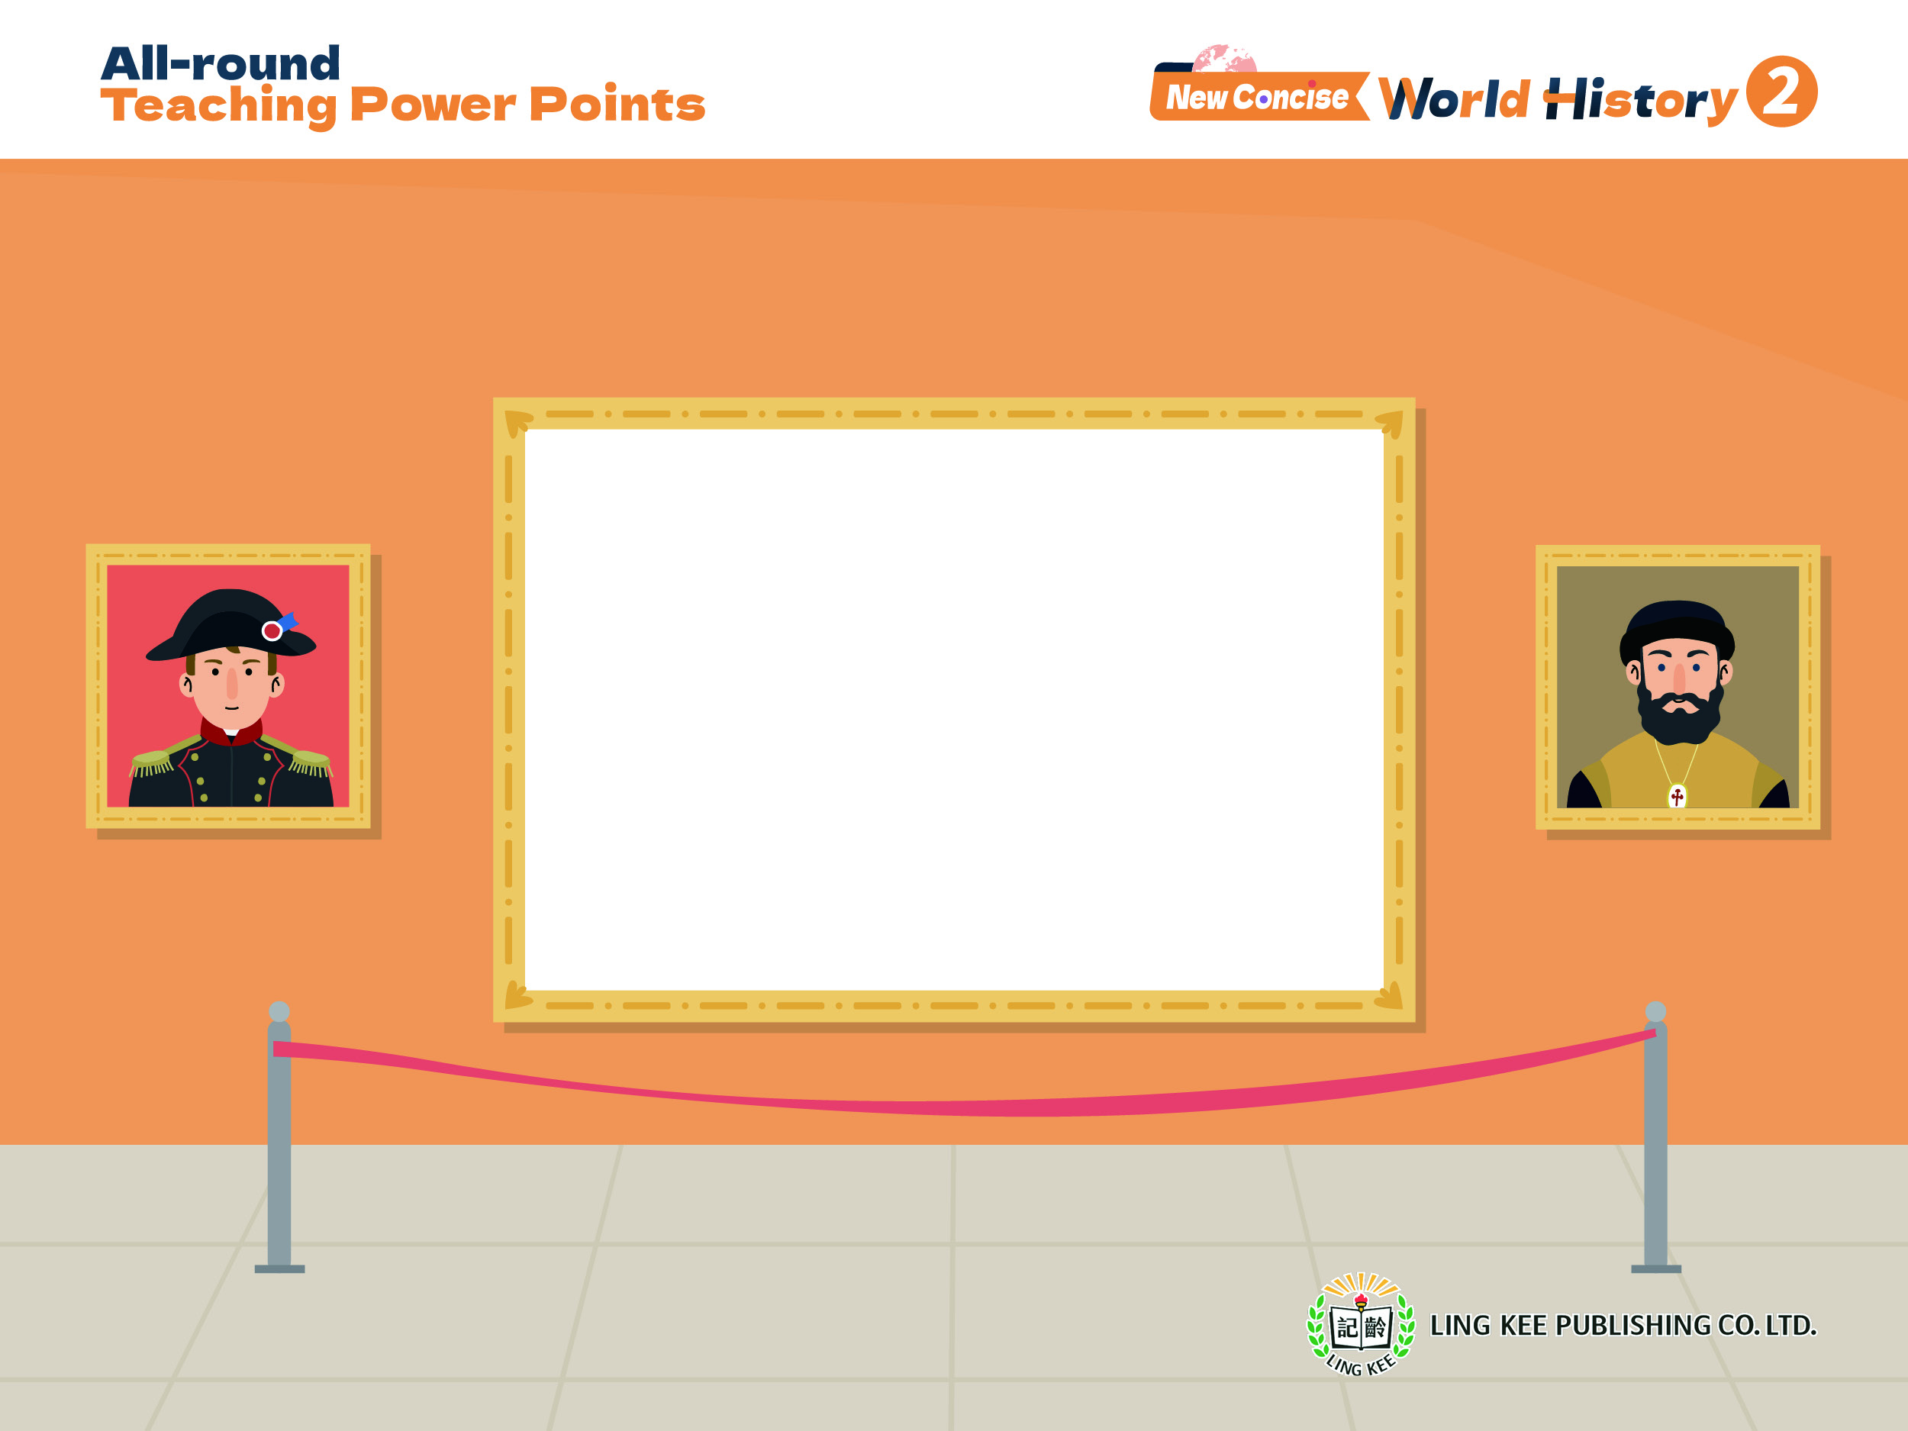
Topic 5 Rise of modern Europe
I From God-centred to human-centred: the Renaissance and the Reformation
Renaissance (2)
2A, pp.11-19

Slide 2

iii. Features of the Renaissance
2A pp.11-19

Slide 3


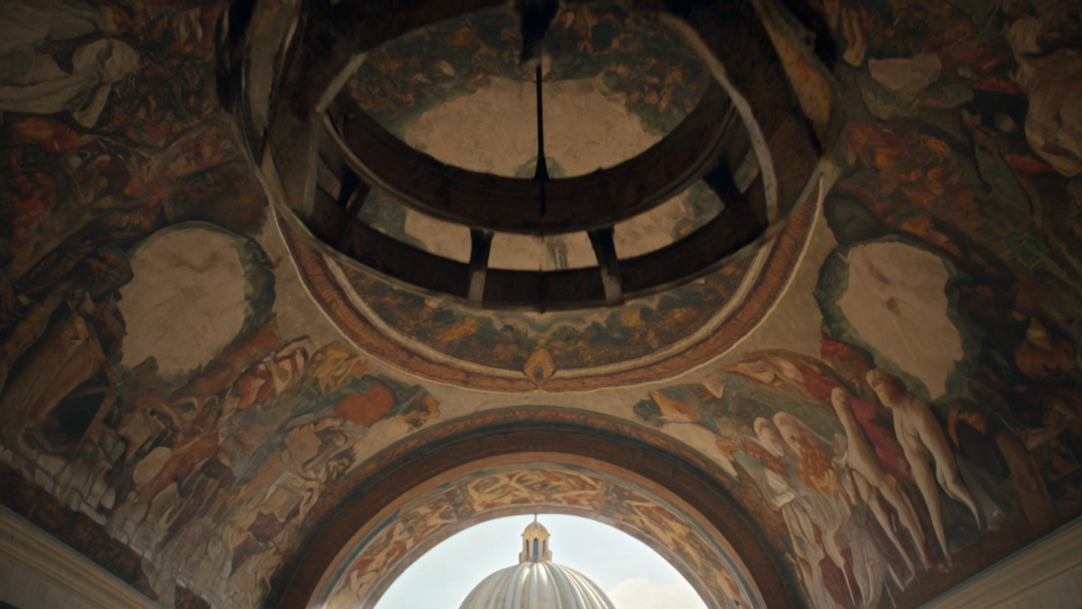
Topic 5
2A p.11
Emphasising humanism
The Renaissance, although called for the restoration of classical civilisation, is essentially a movement of intellectual liberation.

Slide 4
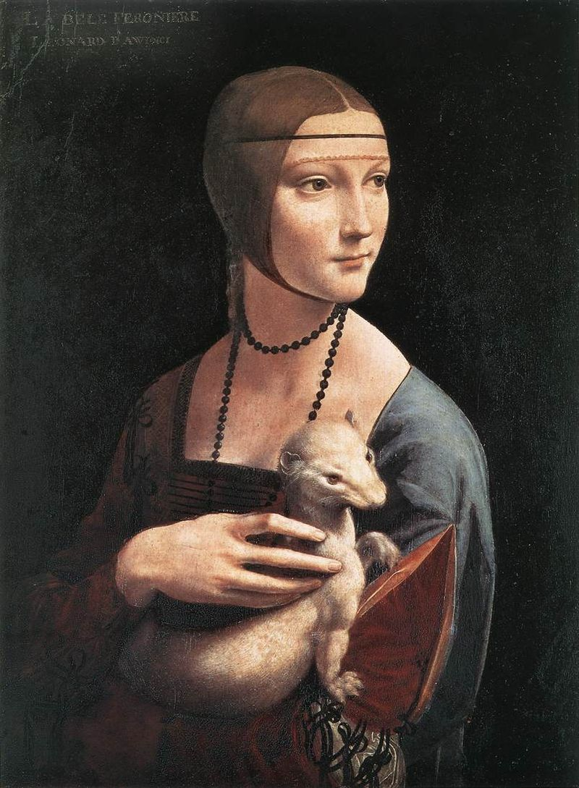
Topic 5
2A p.11
The main spirit of the Renaissance is humanism, a belief that respects the value of human beings as perfect and all-rounded individuals.
Renaissance paintings often feature people as the main subject, as seen in Leonardo da Vinci's Lady with an Ermine

Slide 5
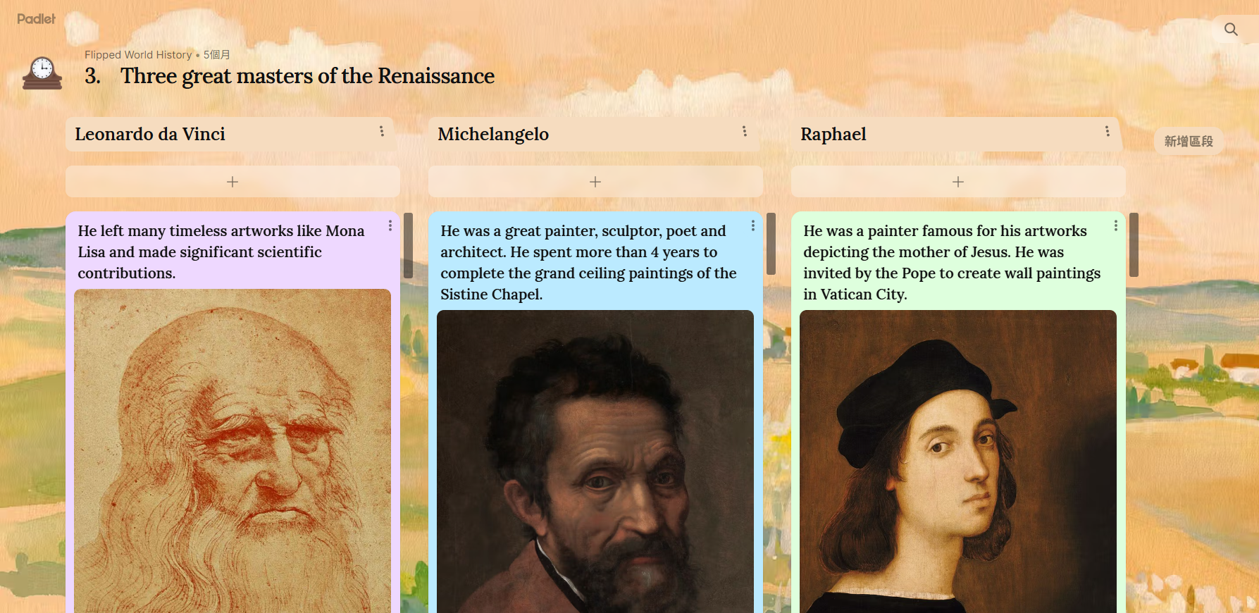

Topic 5
2A p.11
The themes of the artworks at that time were not limited to religious concepts such as heaven.
Rather, the artists included much secular content in their works and emphasised the thoughts and feelings of individuals.
Three great masters of the Renaissance

Slide 6
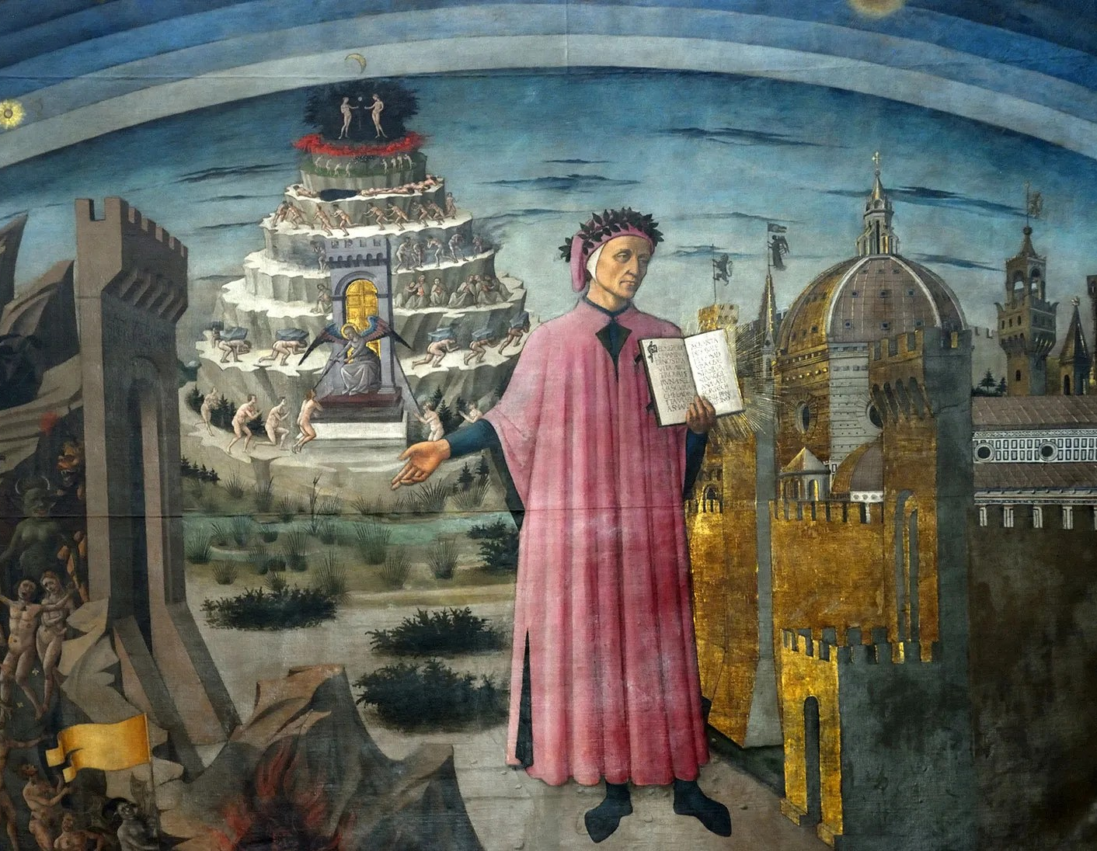
Topic 5
A painting showing Dante holding The Divine Comedy outside the Gate of Hell
2A p.11
The Divine Comedy, written by the Florentine poet Dante, was one of the most representative works at that time.
The poem described the afterlife, uncovered all kinds of evils in the world and criticised the corruption of the Church.

Slide 7
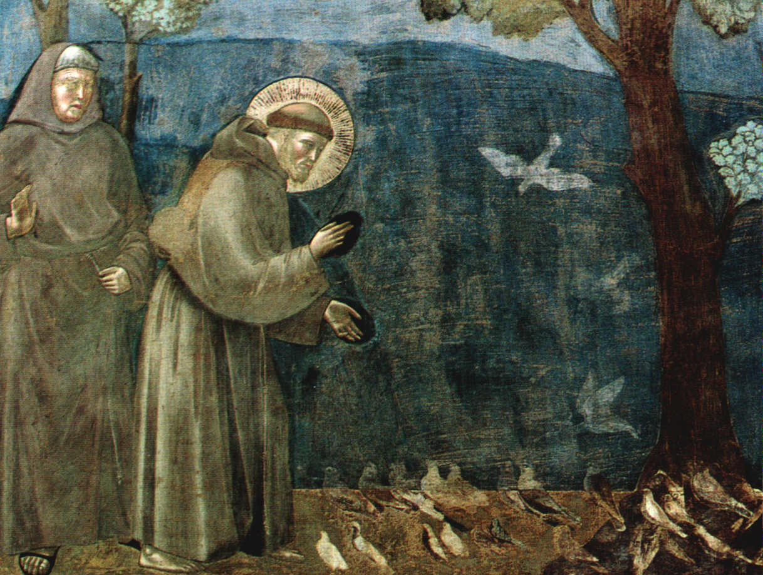
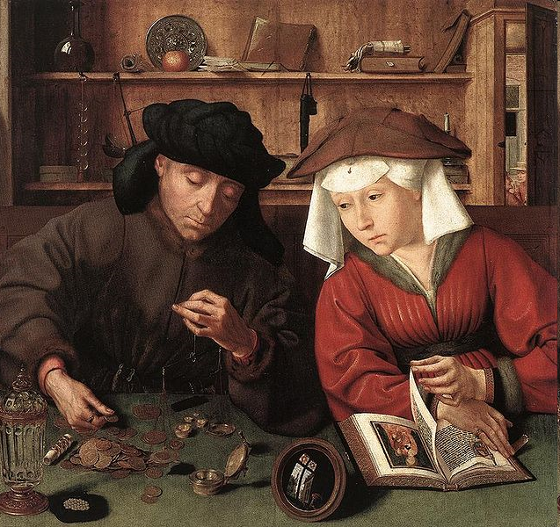
Topic 5
2A p.11
The style of Renaissance painting was lively and realistic, standing in sharp contrast to that of medieval artworks. It also reflected humanism.
Renaissance paintings
Medieval paintings

Slide 8
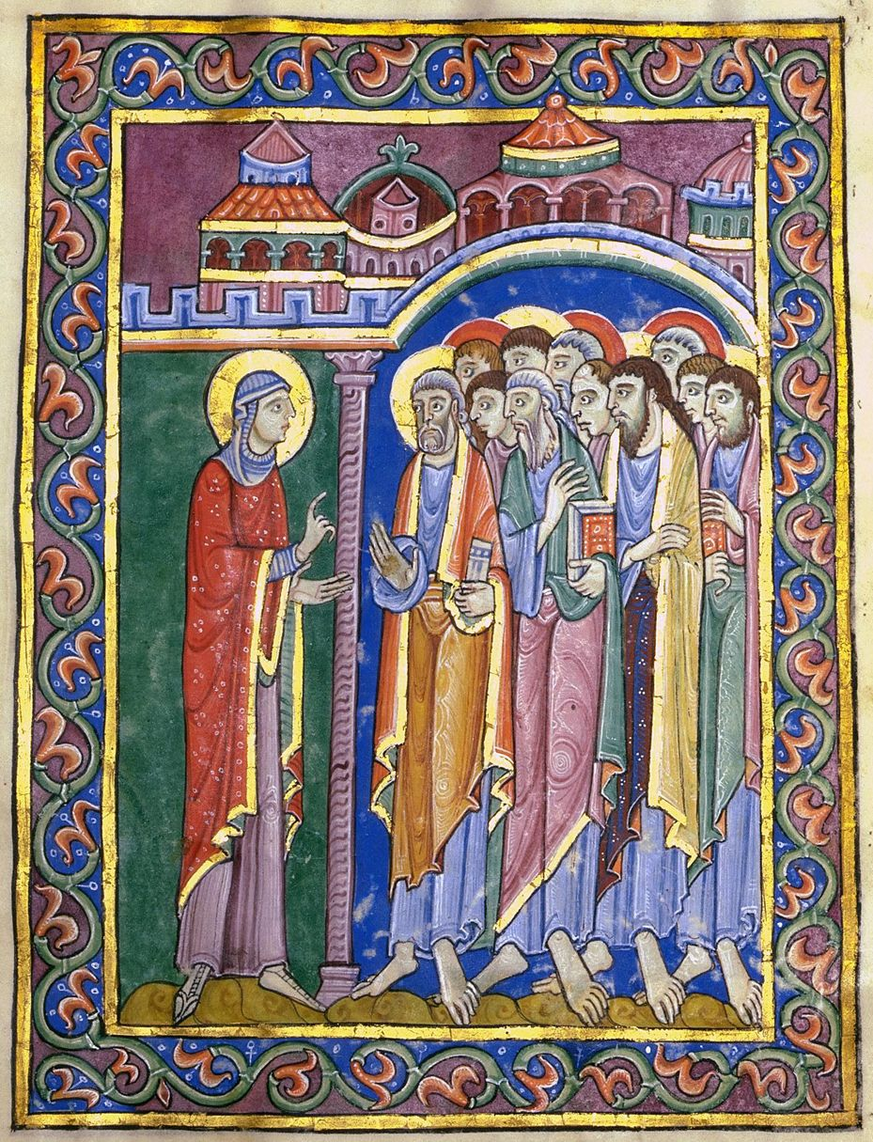
Topic 5
2A p.12
Comparison between the painting styles of the Medieval Times and the Renaissance
Theme︰
Mostly religious
Graphical projection:
Relatively flat, unable to show distance (距離) and depth (深度)
Figures and objects being out of proportion
Style:
Dull colours
Figures looking flat and lifeless, lacking a sense of reality
Medieval painting
Preaching the Resurrection

Slide 9
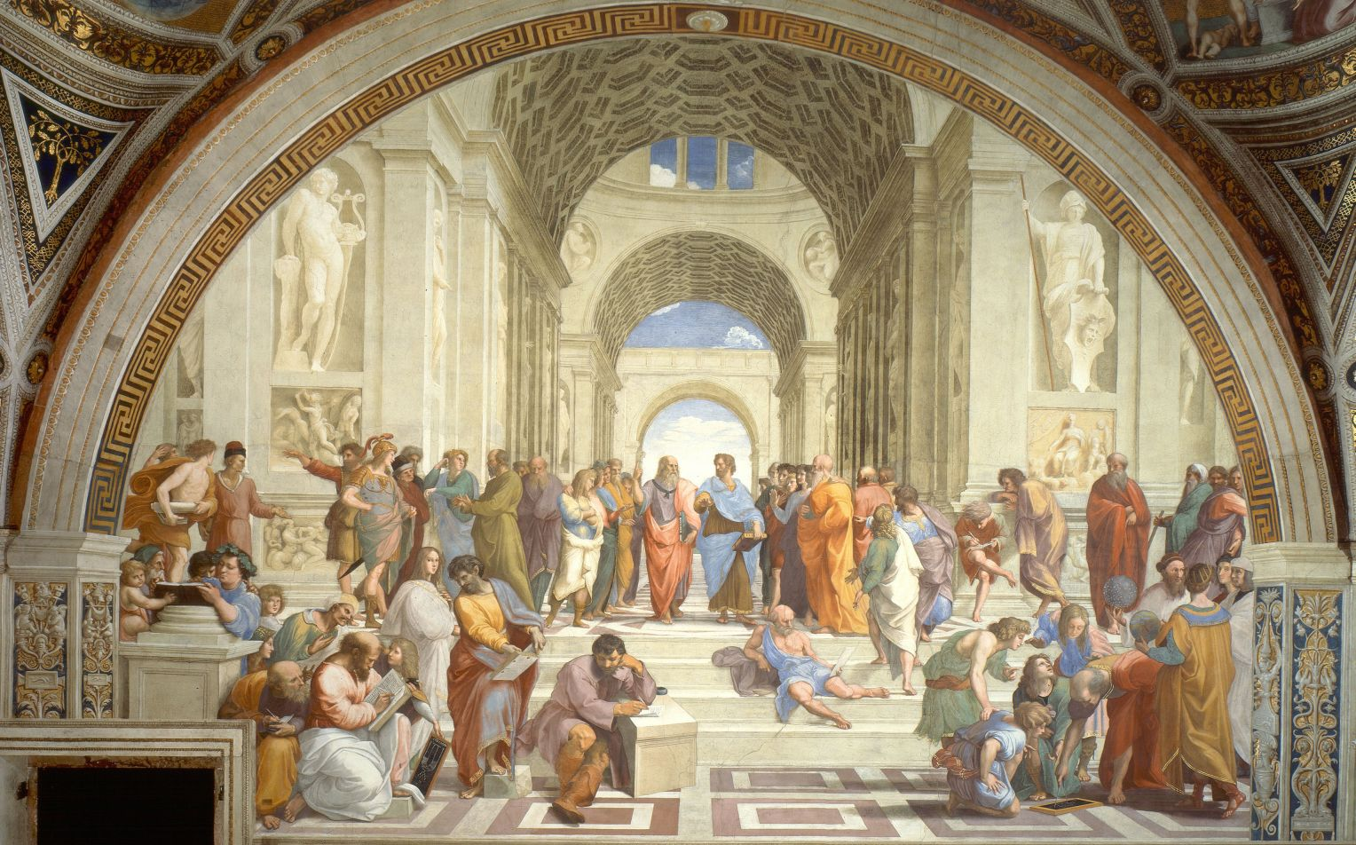
Topic 5
2A p.12
Renaissance painting
The School of Athens (雅典學院) by Raphael
Theme:
Both religious and human

Slide 10
Topic 5
2A p.12
Renaissance painting
The School of Athens (雅典學院) by Raphael
Graphical projection:
Using perspective (透視法) as well as light and shade to show three-dimensional figures and objects at different distance
Figures and objects being in proportion

Slide 11
Topic 5
2A p.12
Renaissance painting
The School of Athens (雅典學院) by Raphael
Style:
Rich colours
Figures looking three-dimensional and more realistic

Slide 12
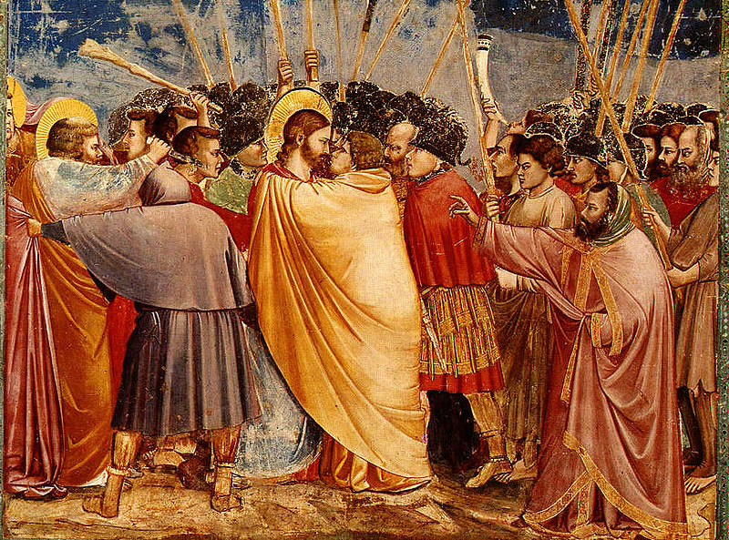
Topic 5
Kiss of Judas, a painting during the Renaissance
2A p.13
2 Reviving classical civilisation
Renaissance thinkers and artists sought to carry forward classical civilisation through reinventing culture and the arts.
While studying ancient Greek and ancient Roman civilisations, they also added new knowledge of their times.

Slide 13
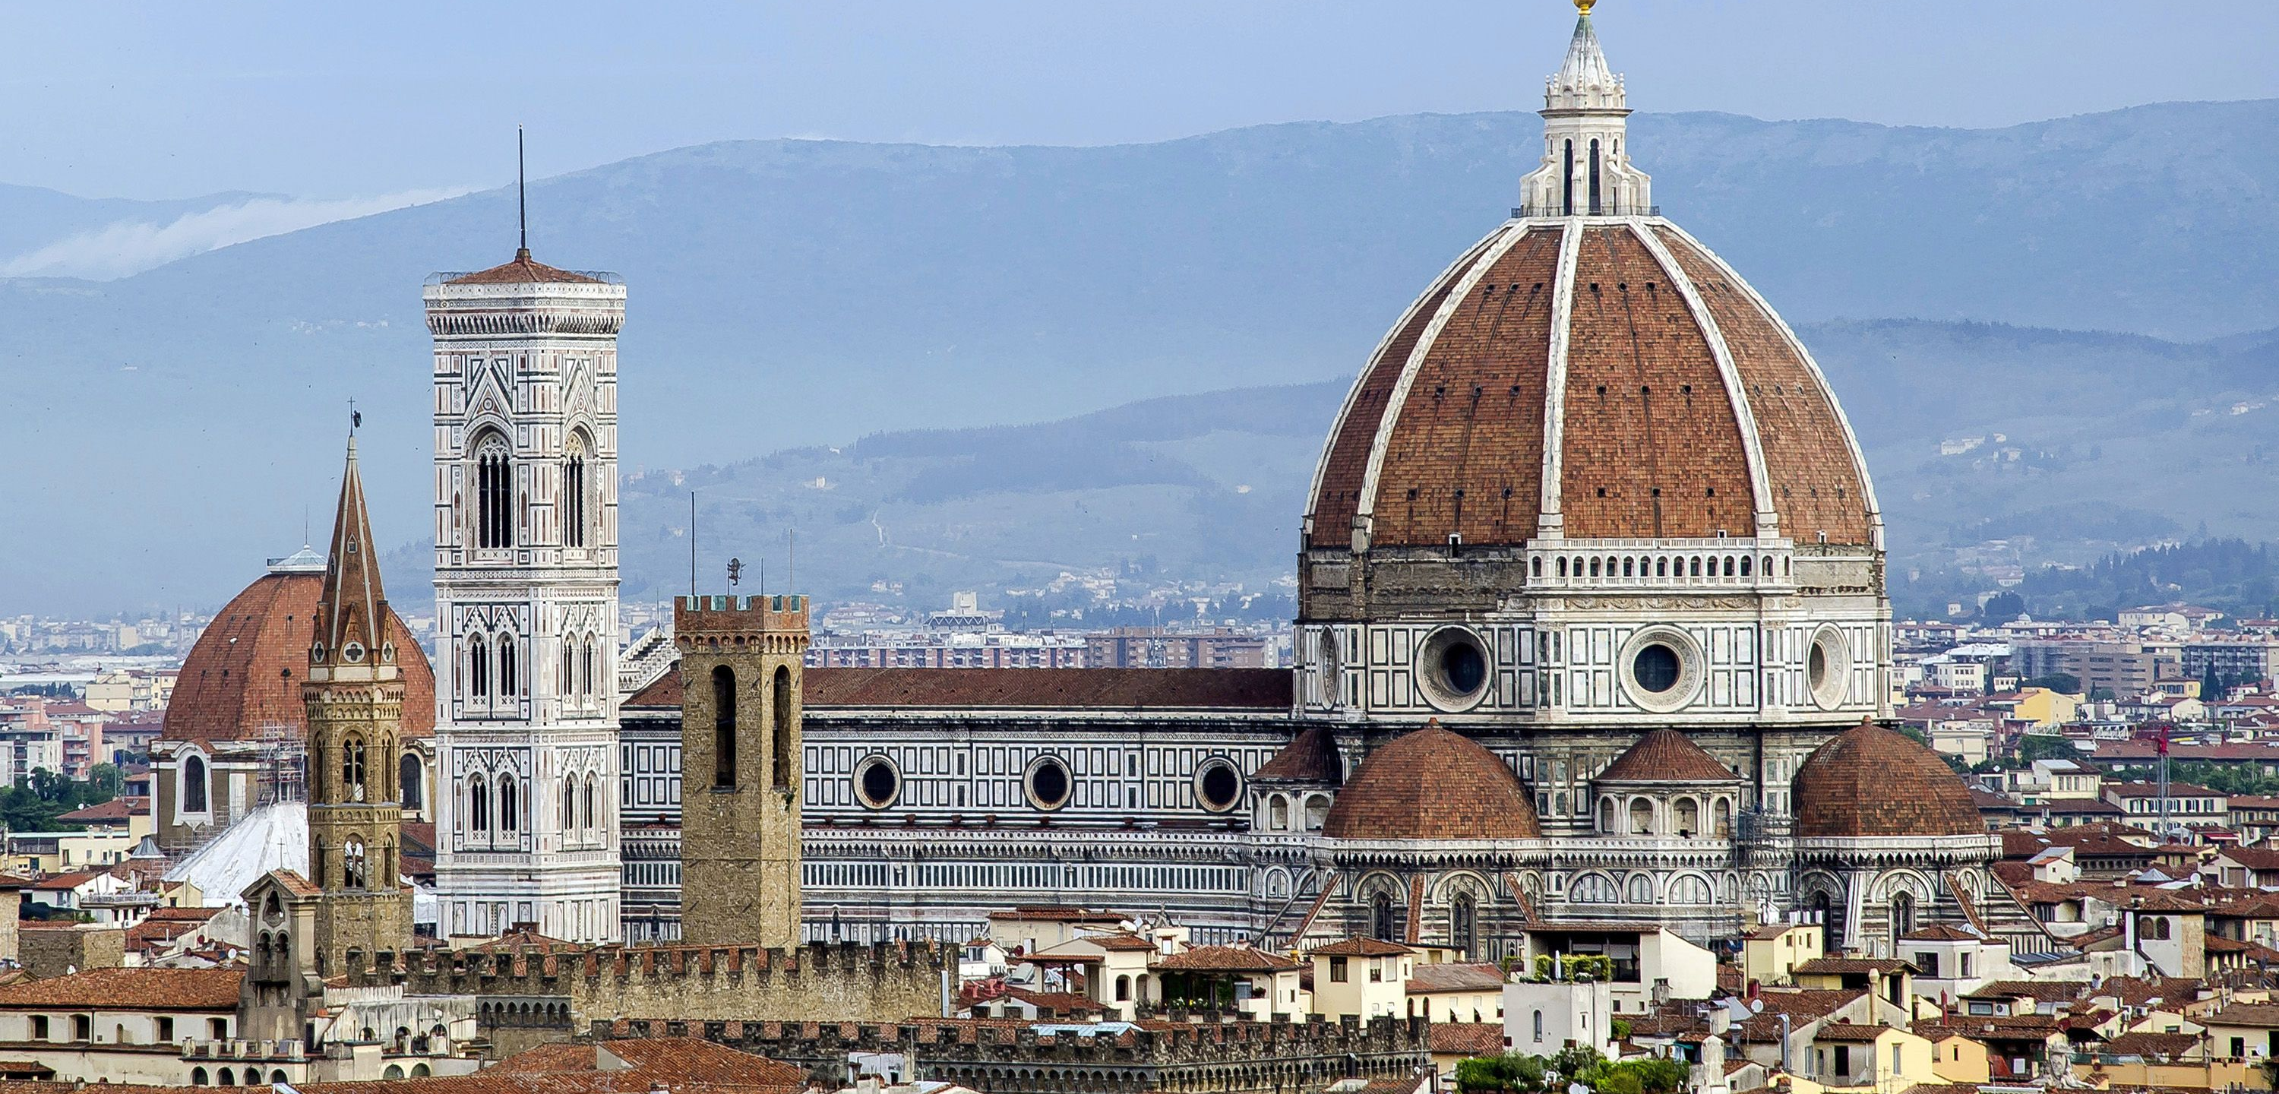
Topic 5
2A p.13
In terms of architecture, other than following ancient Greek and ancient Roman styles, Renaissance buildings also created many new features, such as round columns and dome ceilings.
Cathedral of Saint Mary of the Flower in Florence built during the Renaissance

Slide 14

Topic 5
2A p.13
Identify the characteristic of the roof of the Cathedral of Saint Mary of the Flower.
Vaulting dome.
Cathedral of Saint Mary of the Flower in Florence built during the Renaissance

Slide 15
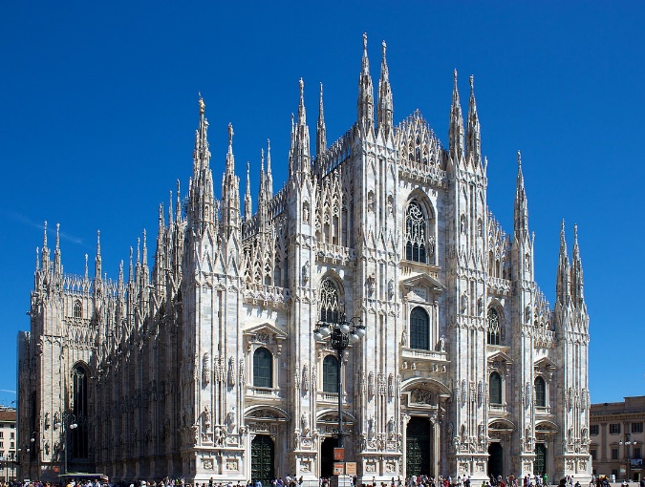
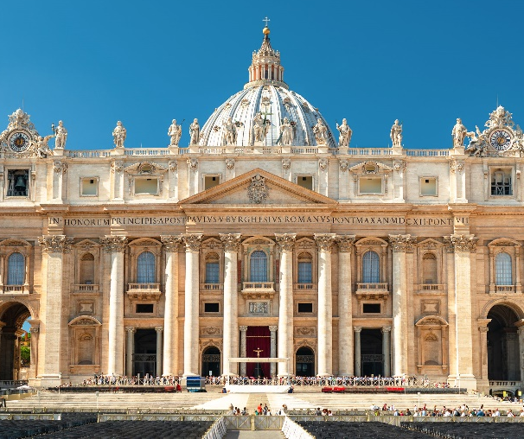
Topic 5
2A p.13
Medieval and Renaissance architectural styles
 | Medieval Times | Renaissance
Arch | Pointed arches | Ancient Roman-style arches
Roof | Tall pointed towers | Vaulting dome
Stained glass window | Colourful stained glass windows | No
Column | No | Yes

Slide 16

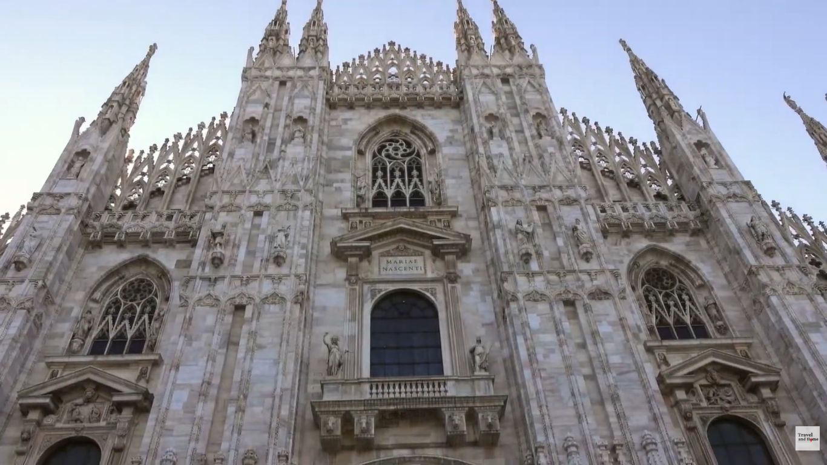
Topic 5
2A p.13
YouTube Video: The Cathedral of Milan

Slide 17
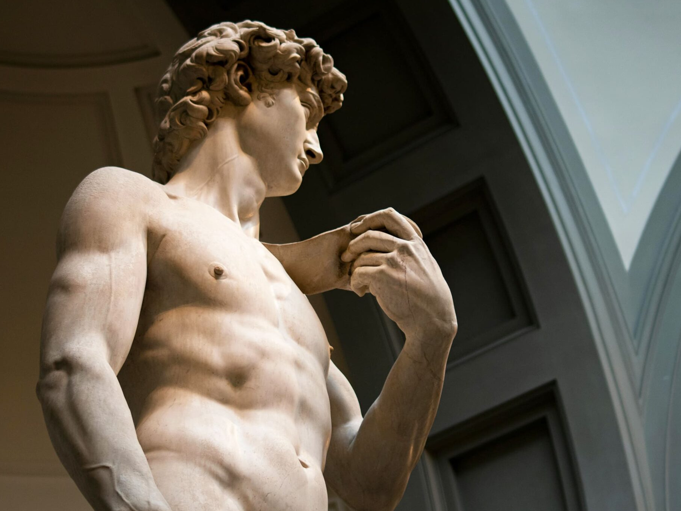
Topic 5
David (大衞像) by Michelangelo
2A p.14
Sculpture
Medieval Times
Most medieval sculptures were carved onto the buildings.
The Renaissance
Free-standing statues, which had been popular in ancient Greek and ancient Roman times, became the mainstream again.

Slide 18
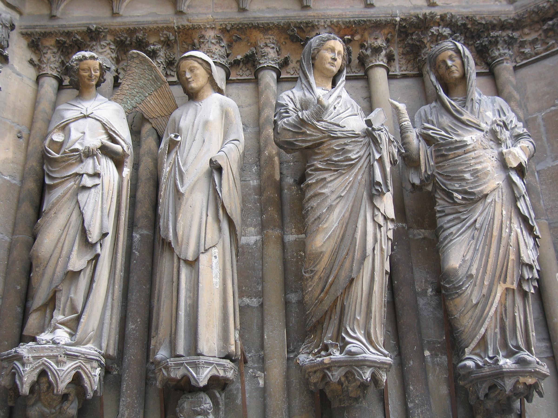
Topic 5
2A p.14
The Visitation, a sculpture in Notre Dame Cathedral, Reims, France

Slide 19
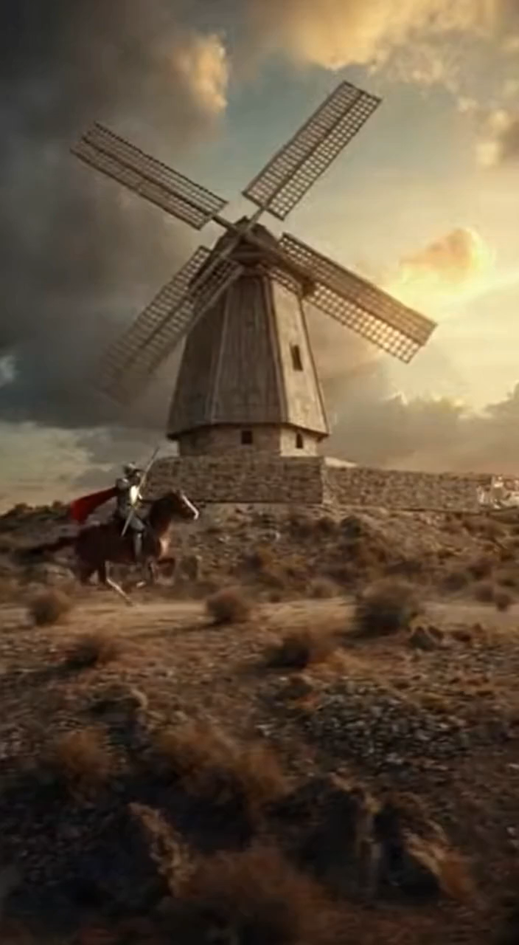
Topic 5
2A p.14
3 Promoting personal
striving
The Renaissance encouraged personal striving, emphasising individual freedom of speech and creativity.
It also opposed control of unreasonable systems over human thoughts.
Don Quixote by Miguel de Cervantes criticised the feudal society and the knighthood and expressed sympathy to the poor people.

Slide 20
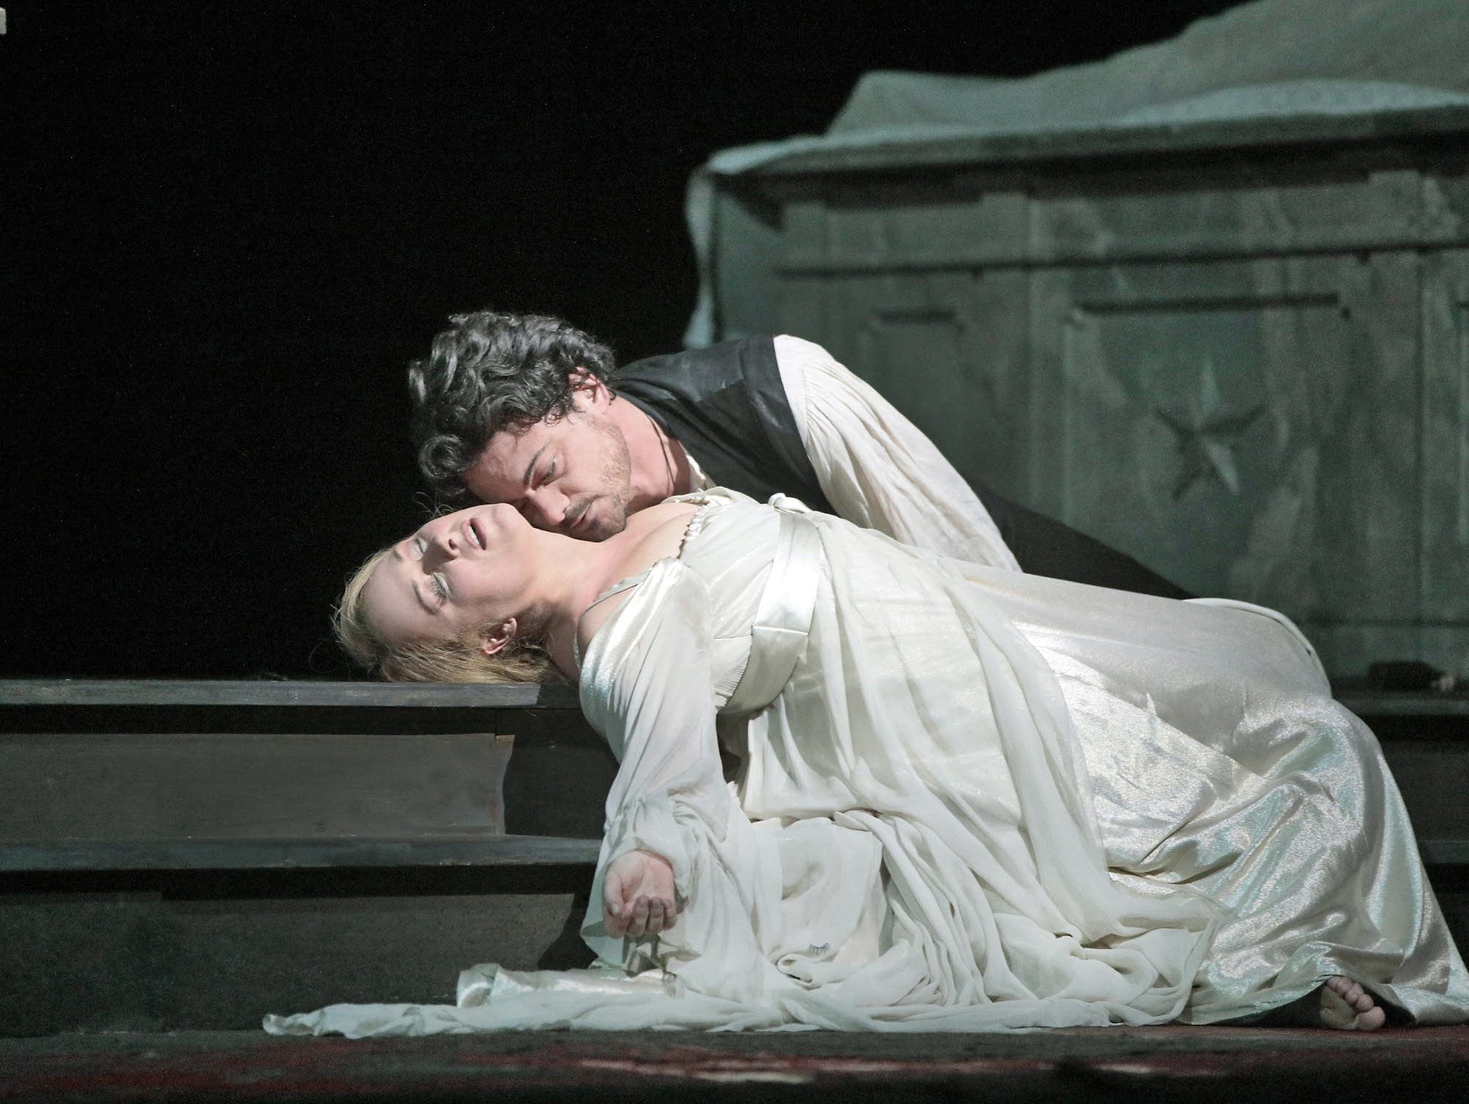
Topic 5
2A p.14
William Shakespeare, a British playwright, not only described the dark side of 16th century society in his works, but also gave praises to kindness and righteousness.
A modern-day Romeo and Juliet theatre play

Slide 21
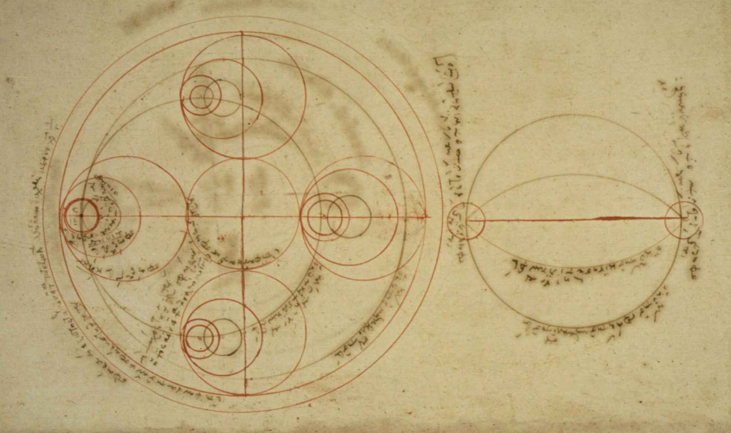
Topic 5
2A p.15
4 Daring to question
During the Renaissance period, people were brave enough to doubt the old systems, cultures and thoughts.
Many scientists began to challenge the Church's explanation of how the world worked. They also raised new scientific theories.
Manuscripts of astronomical Research during the Renaissance

Slide 22
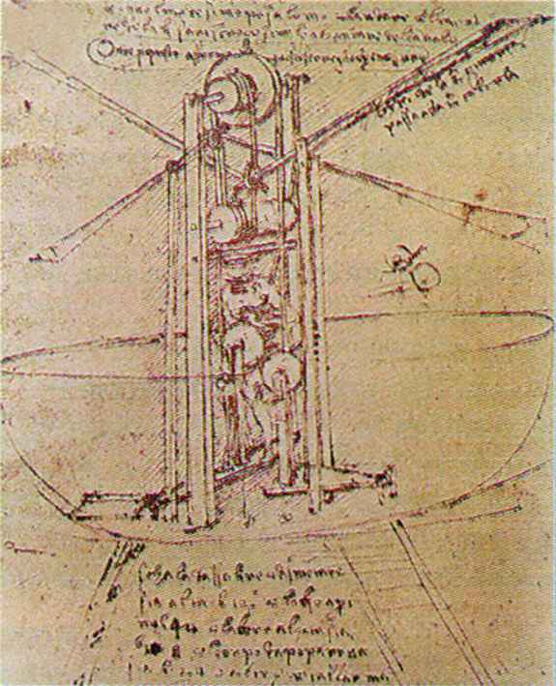
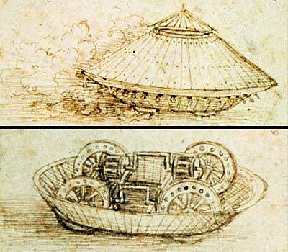
Topic 5
2A p.15
Leonardo da Vinci left behind many studies on military engineering and anatomy.
Invention sketches by Da Vinci

Slide 23


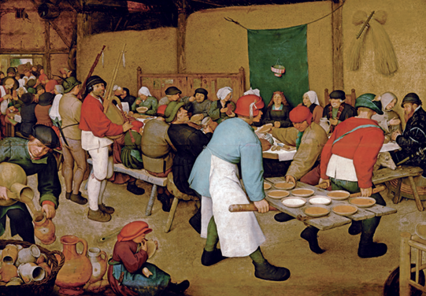
2A pp.16-17
Influence of Renaissance thoughts on the art of painting
Study the sources below and answer the following questions.
Source A Painting entitled The Peasant Wedding

Slide 24
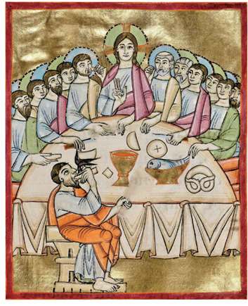
2A pp.16-17
Source B Painting entitled The Last Supper

Slide 25
2A pp.16-17
1. Comparing Sources A and B, which painting looks more realistic？Explain your answer.
Observe sources
Source ____looks more realistic because it seems
( three-dimensional / flat ). In addition, the figures drawn are ( lifeless / lively ).
A

Slide 26
2A pp.16-17
2. What is the difference between the themes of Sources A and B? Cite clues from the sources to explain your answer.
Analyse and compare sources
Source A is on the theme of ( religious story / people's lives ). It represents the scene of a wedding ceremony of _________. Source B is on the theme of ( religious story / people's lives ). It represents the scene of _____________________ having the last supper.
peasants
Jesus and his disciples

Slide 27
2A pp.16-17
3. Identify which respective period Sources A and B belonged to using your own knowledge.
Analyse sources
Source A is a work from the Renaissance period, while Source B is a work from the Medieval Times.

Slide 28

2A pp.16-17
4. Referring to the question above, explain why different themes emerged in the two periods you mentioned.
Explain reasons
Which period did Source A belong to? What was the main spirit of that period?
Compare the two periods. How did the influence of the Church change?

Slide 29
2A pp.16-17
The painting in Source A was created during the Renaissance. The main spirit at that time was humanism and the emphasis on human value. As for the paintings in Source B created in the Medieval Times, the themes at the time were mainly religious. Therefore, the paintings in Source A depict civilians and take secular life as their themes, and are no longer limited to the religious content of the paintings in Source B.

Slide 30




Topic 5
2A pp.11-19

