Slide 1
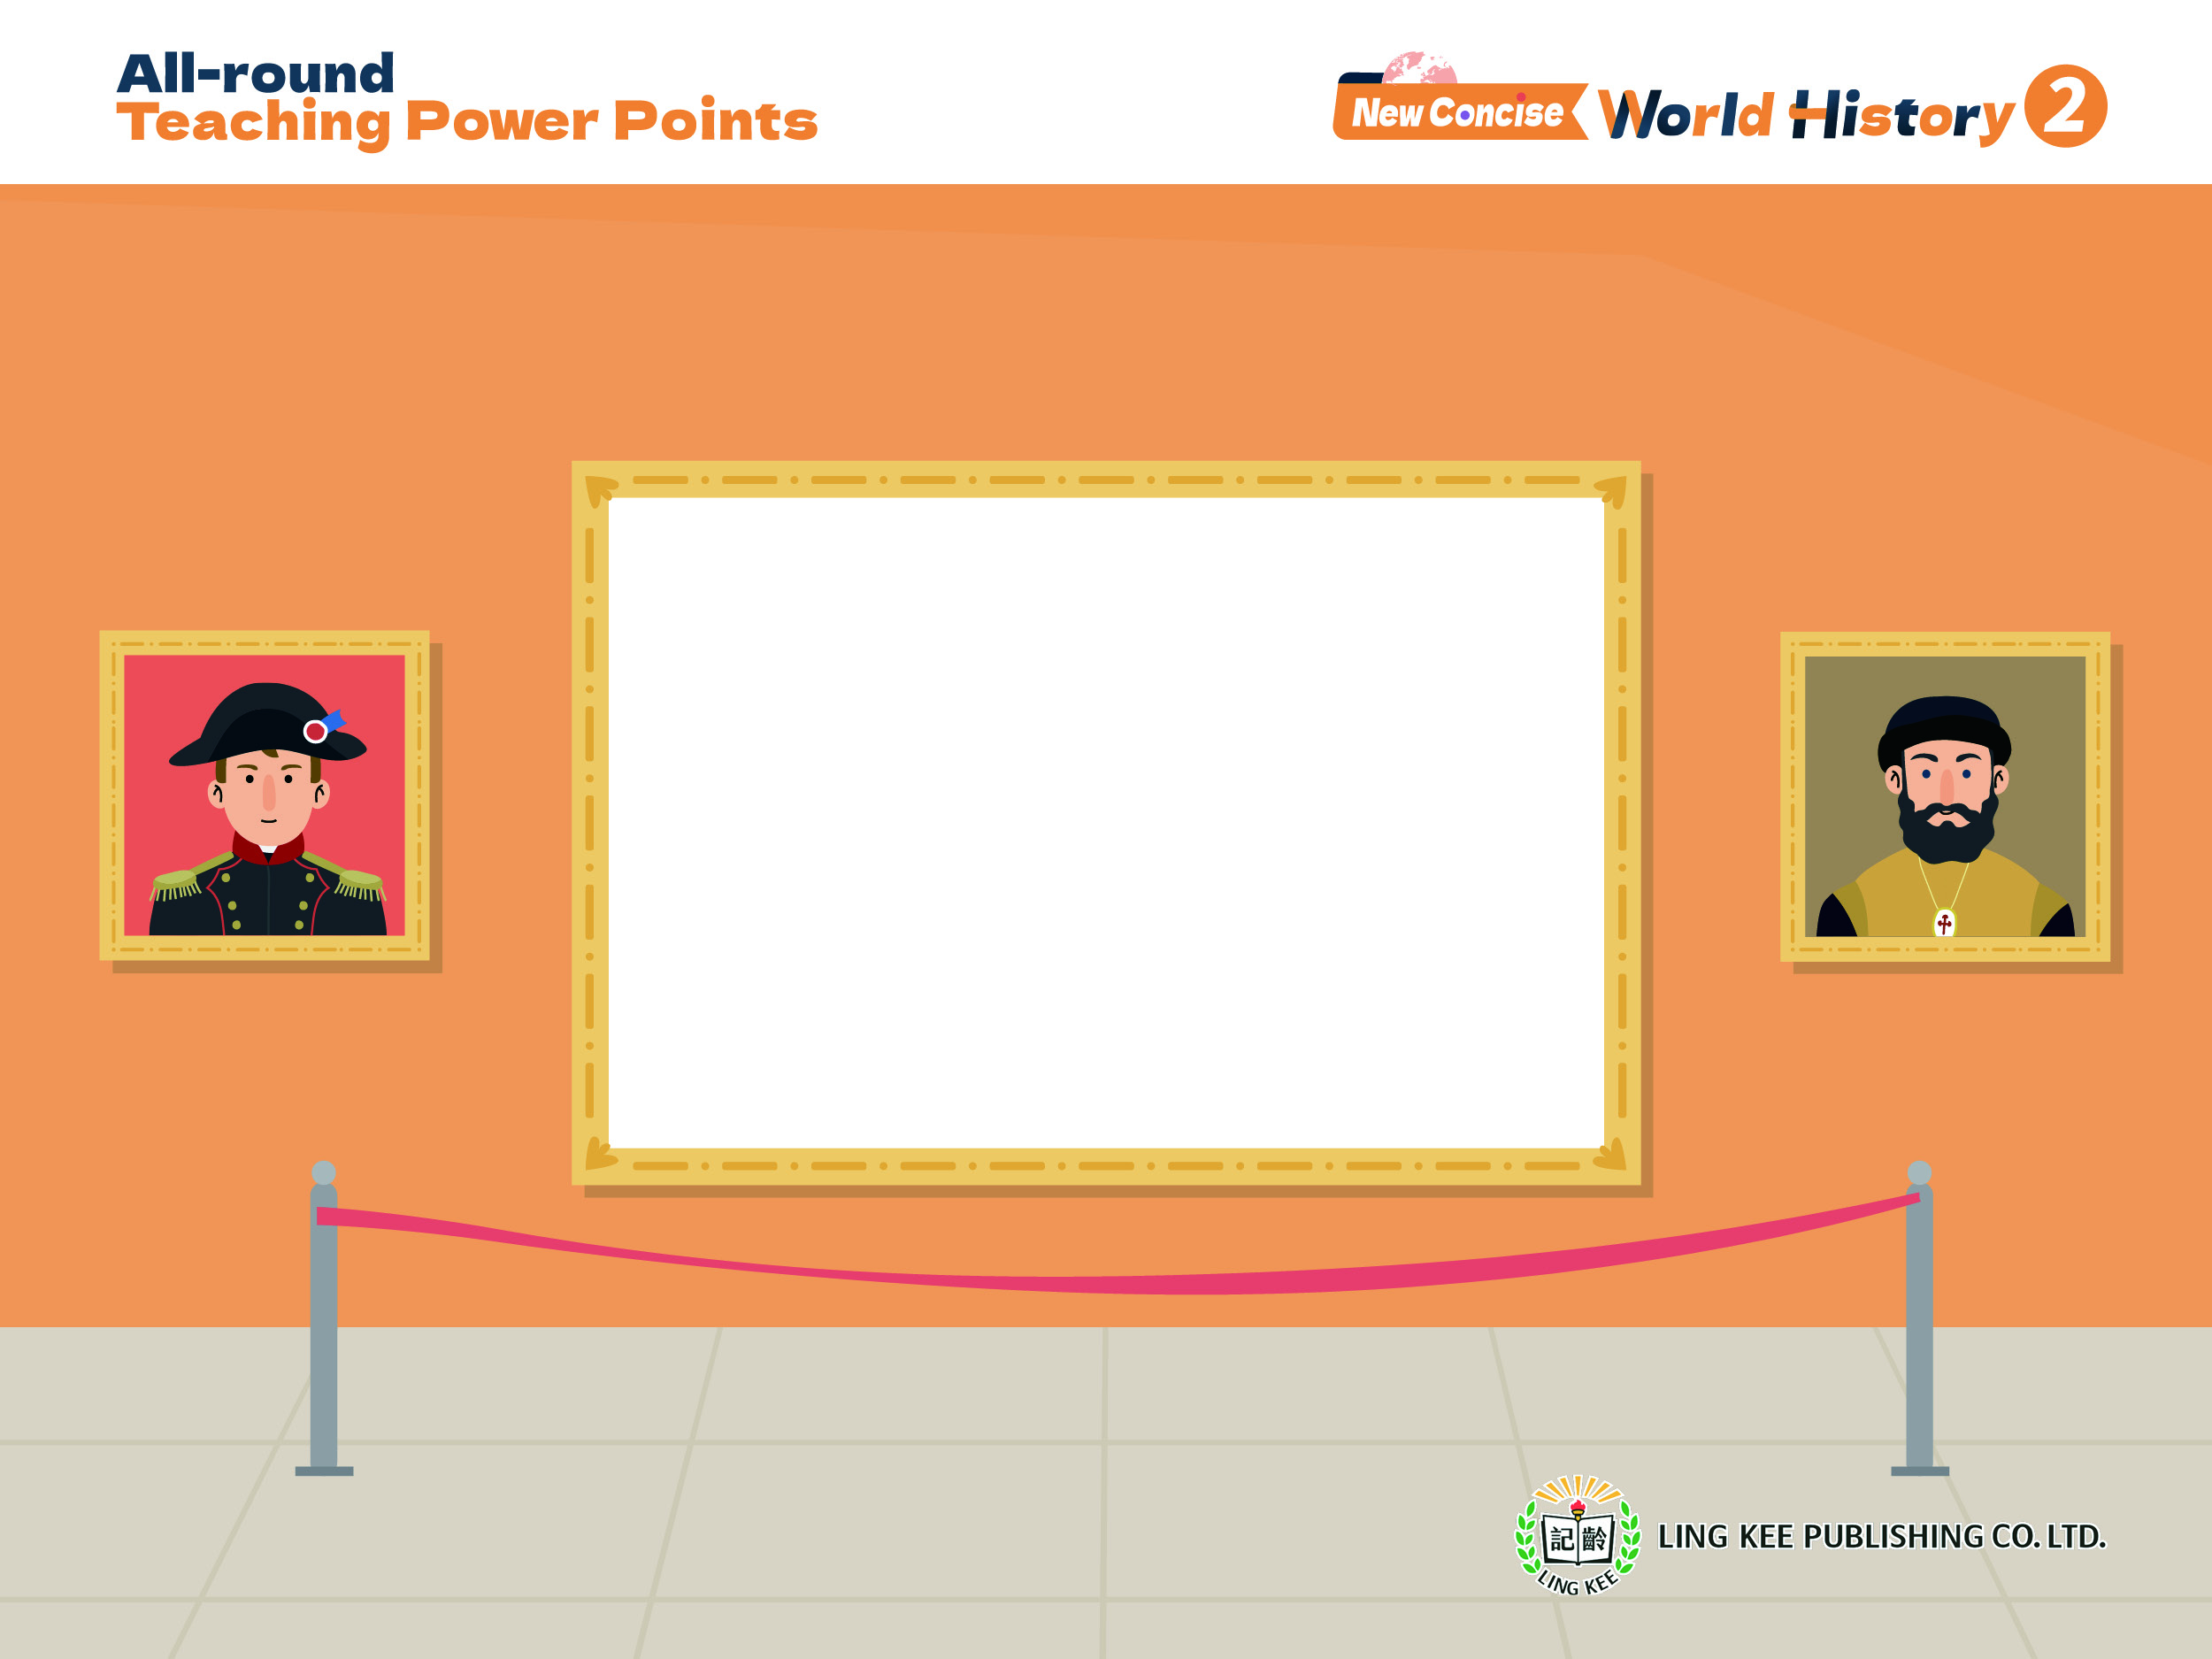
Topic 5 Rise of modern Europe
I From God-centred to human-centred: the Renaissance and the Reformation
Renaissance (3)
2A, pp.20-22

Slide 2

iv. Impact of the Renaissance
2A pp.20-22

Slide 3

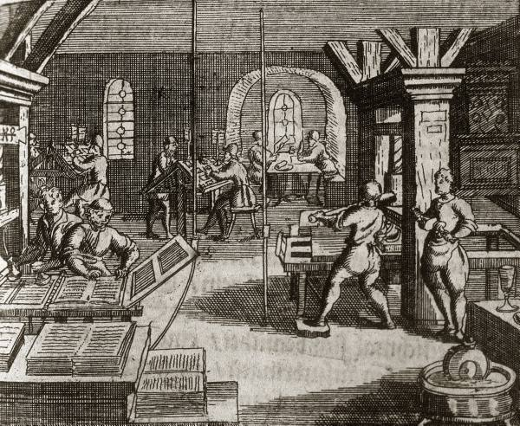
Topic 5
2A p.20
Laying the foundation for early modern European civilisation
During the Renaissance, many scholars had greater achievements than their predecessors in various fields, including literature, painting, sculpture, architecture and science.
This laid the foundation for the early modern civilisation of the West.
The development of the printing technology shortened the printing time, facilitating the spread of ideas

Slide 4
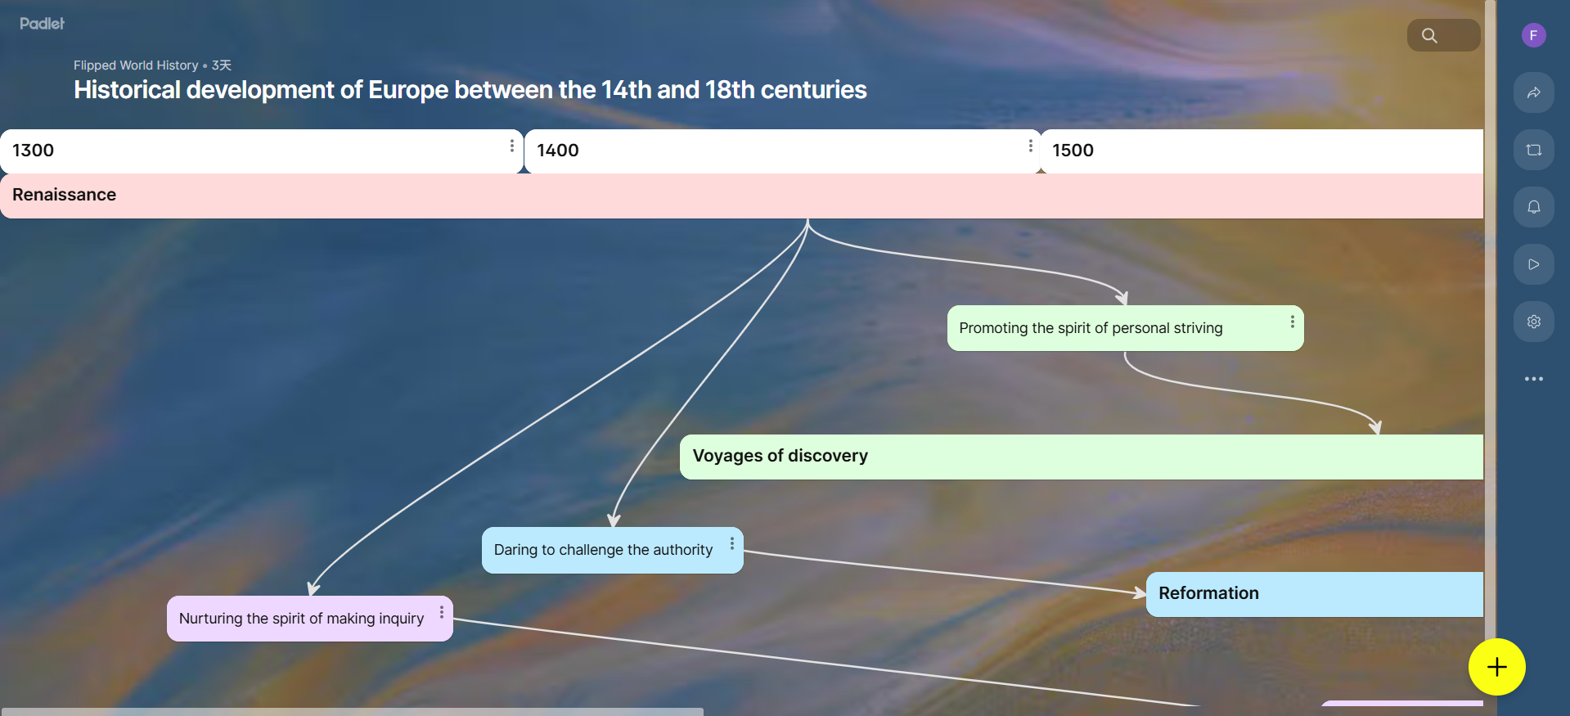

Topic 5
2A p.20
Hence, the Renaissance is viewed as a milestone for Europe's transition from the Medieval Times to early modern times.
Historical development of Europe
between the 14th and 18th centuries

Slide 5
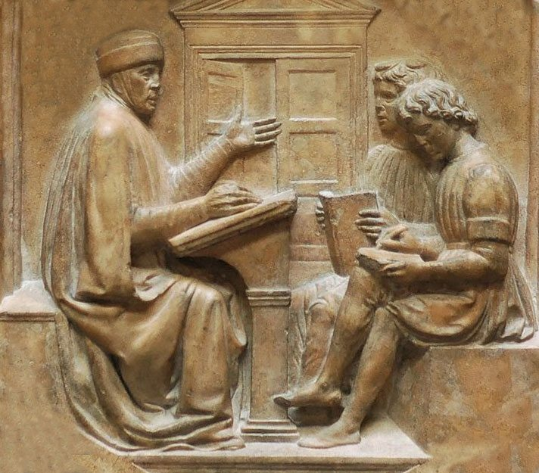
Topic 5
2A p.21
2 Leading to the Reformation
Due to the Renaissance, people started to doubt the authority of the Church and eagerly challenged it.
Students learning grammar during the Renaissance

Slide 6
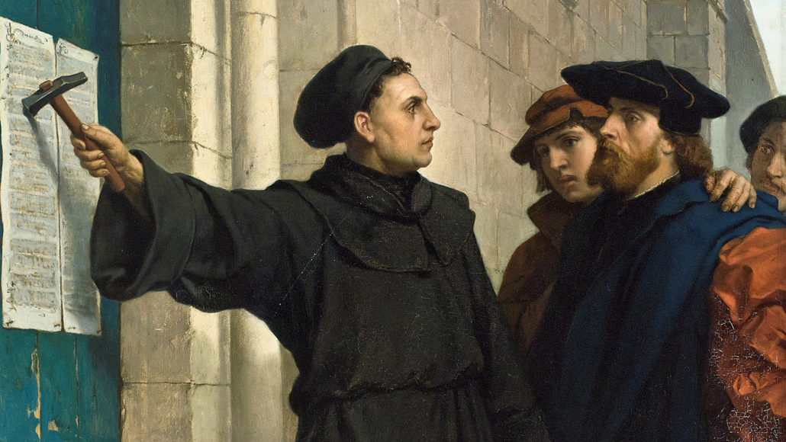
Topic 5
2A p.21
Martin Luther posting the Ninety-Five Theses on the door of a church
In 1517, Martin Luther, a German monk, openly posted his ideas criticising the Church.
This led to the rise of the Reformation in Europe.

Slide 7


Topic 5
2A p.21
3 Prompting the voyages of discovery
The Renaissance encouraged the spirit of personal striving, making people eager to sail across the sea.
Since the 15th century, navigators from Western Europe had successively discovered new routes connecting the East and the West, and even the New World of the Americas.

Slide 8
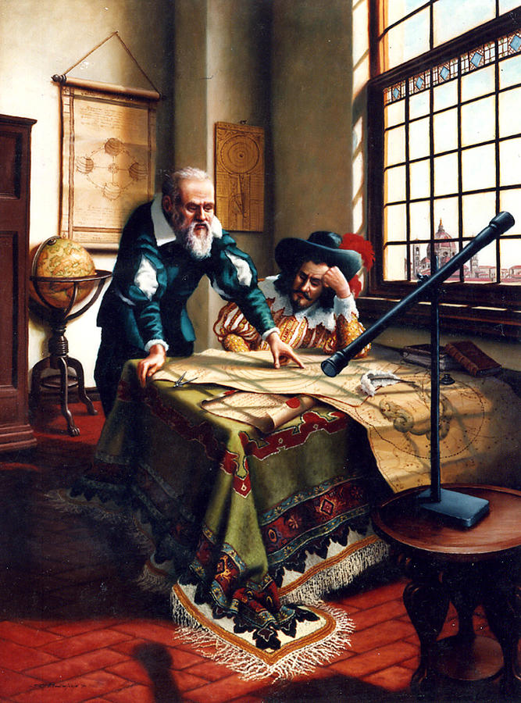
Topic 5
2A p.21
4 Leading to the Scientific Revolution
The Renaissance weakened the control of the Church over culture and knowledge.
People gradually developed the spirit of questioning and making inquiry, leading to the emergence of the Scientific Revolution in mid-16th-century Europe.
Galileo, a renowned figure of the Scientific Revolution

Slide 9
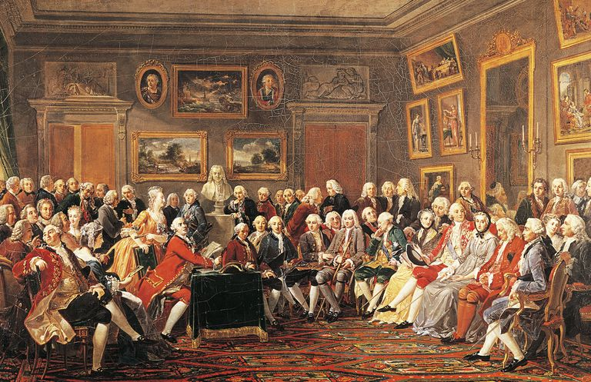
Topic 5
2A p.21
5 Influencing the Enlightenment
The Renaissance promoted intellectual liberation among people.
French Enlightenment thinkers discussing politics

Slide 10
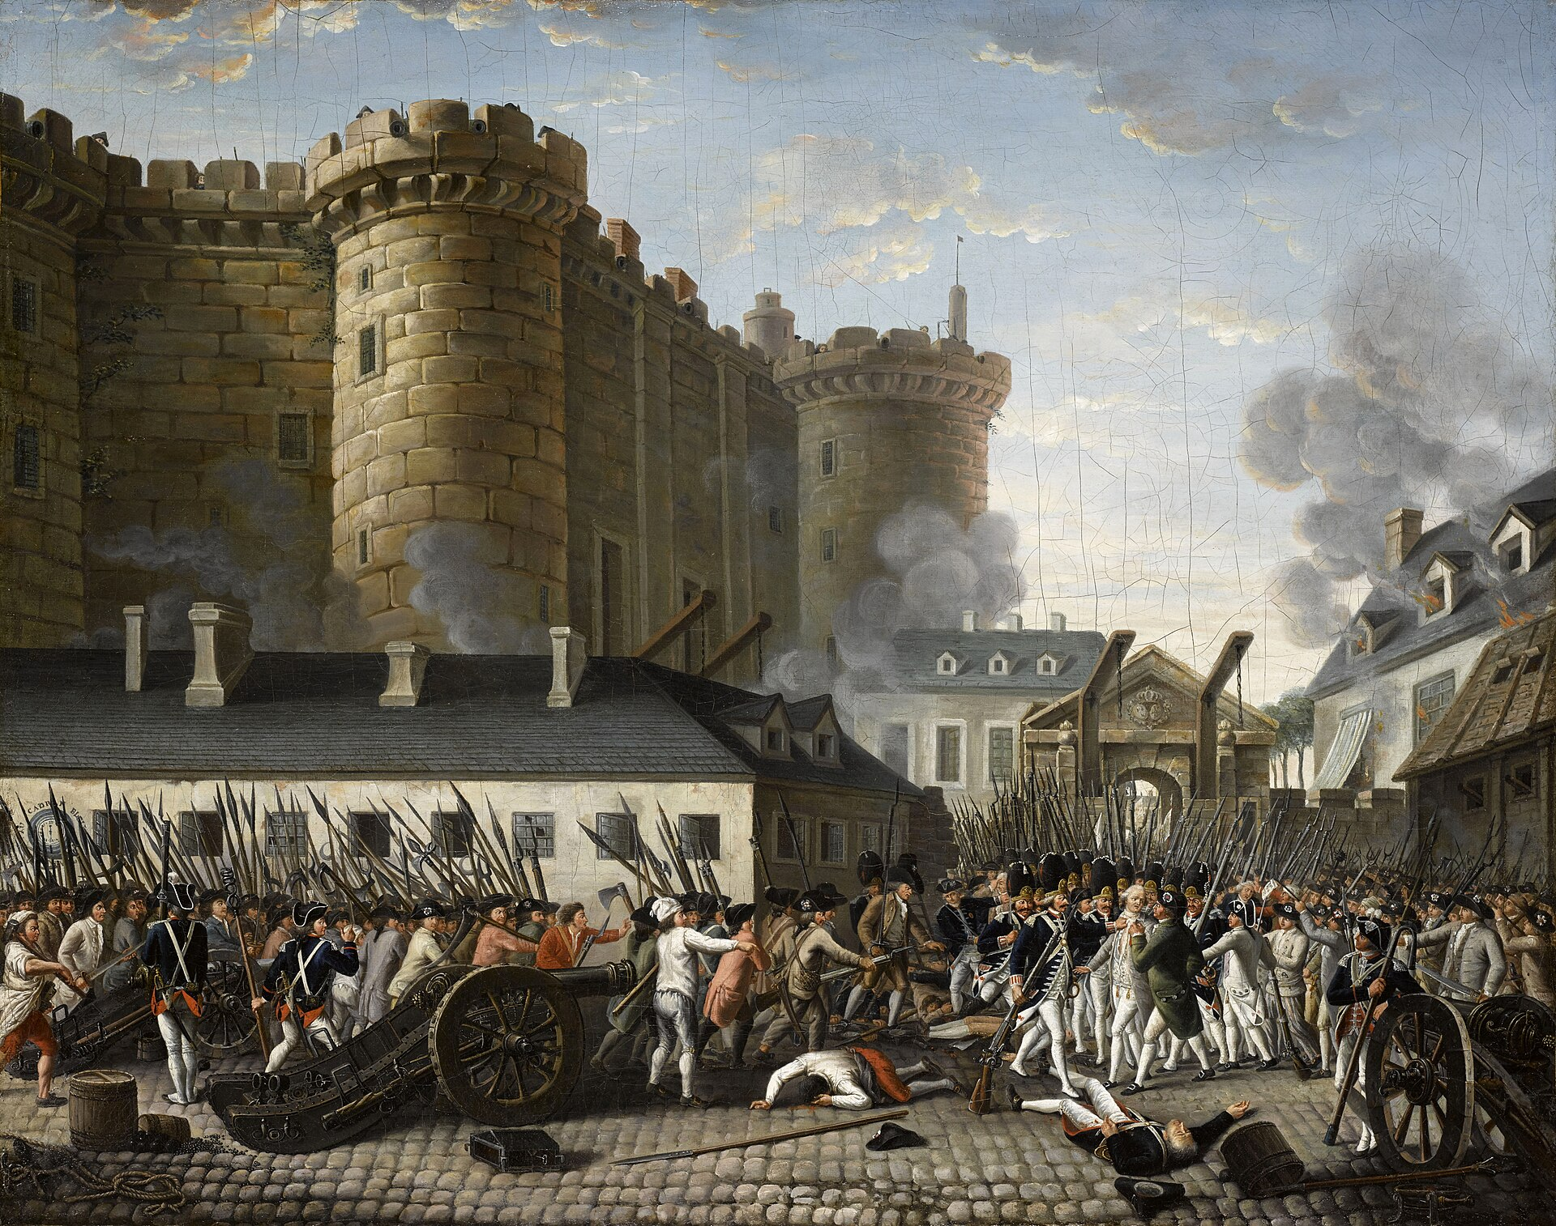
Topic 5
2A p.21
During the 17th and 18th centuries, the Enlightenment, which called for social transformation, began in France and spread throughout Europe.
This movement had far-reaching impact on Europe's intellectual development.
The Enlightenment promoted the French Revolution in the 18th century

Slide 11
Topic 5
2A p.22
Comparison between Medieval thoughts and Renaissance thoughts
Medieval Times
Renaissance
God-centrism, the Church having great influence
Humanism, viewing humans as the centre
On the theme of religious stories
Written in Latin
On the theme of human topics
Written in native languages
Literature
Painting
Relatively flat, lacking dimensions
Dull colours
Three-dimensional and realistic
Rich colours

Slide 12
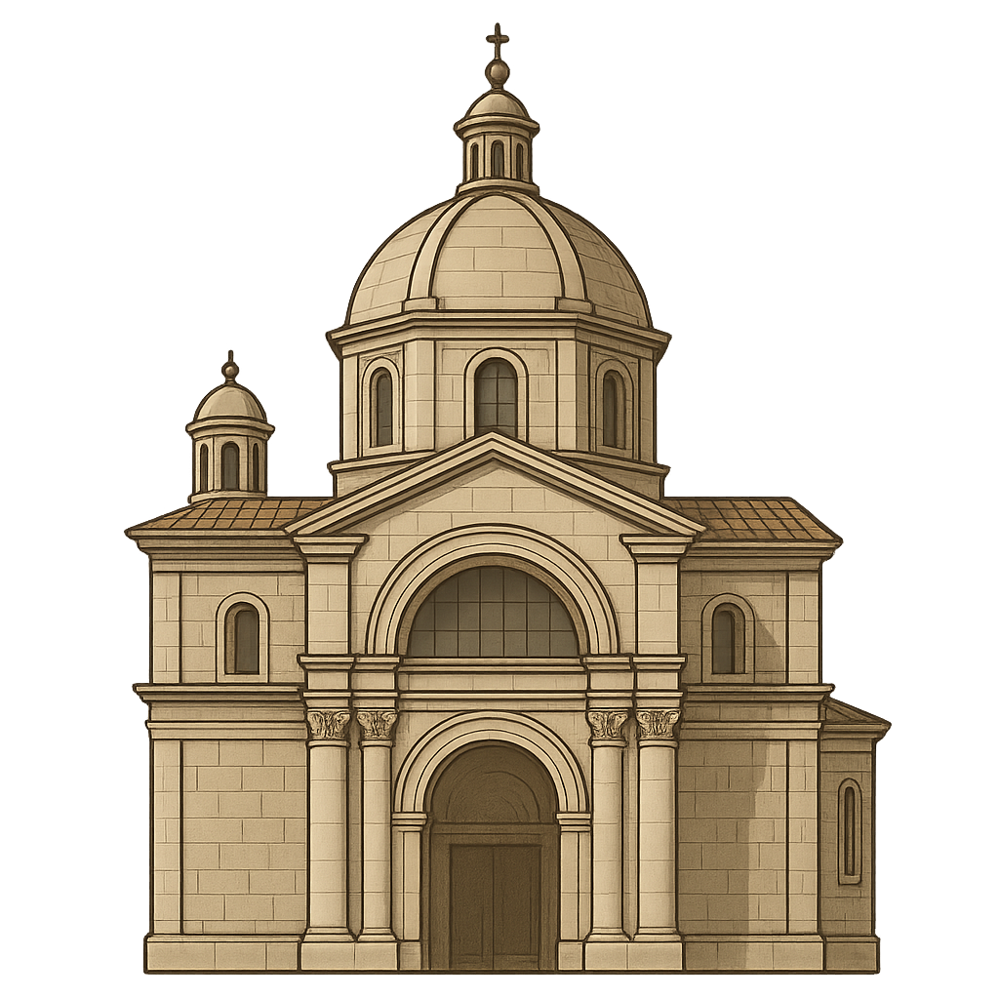
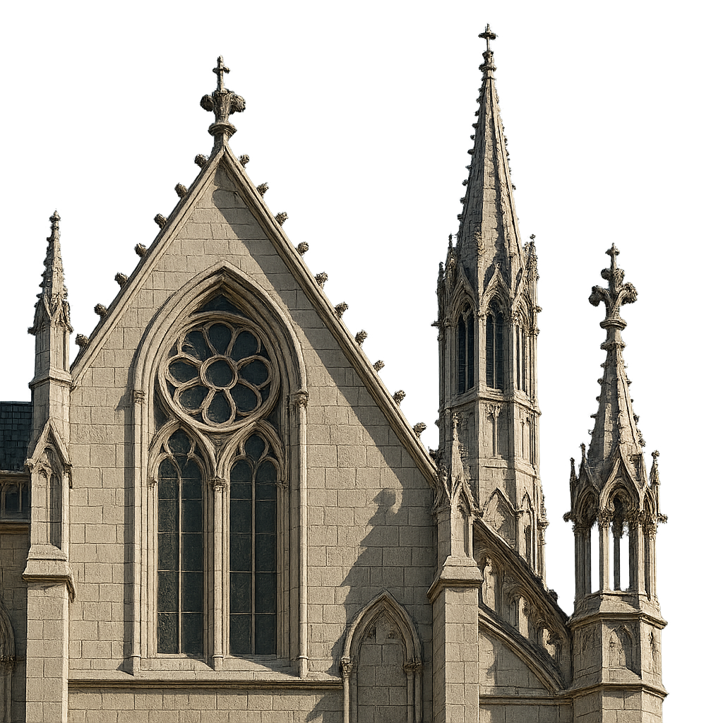
Topic 5
2A p.22
Medieval Times
Renaissance
Carved onto the buildings, lacking variety
Free-standing statues with lively and
complex images
Sculpturing
Adopting the
Gothic style
Following ancient Greek and
ancient
Roman styles
Architecture
The Church supporting the idea that Earth was the centre of the universe
Astronomers suggesting that the Sun was the centre of the universe
Astronomy

Slide 13

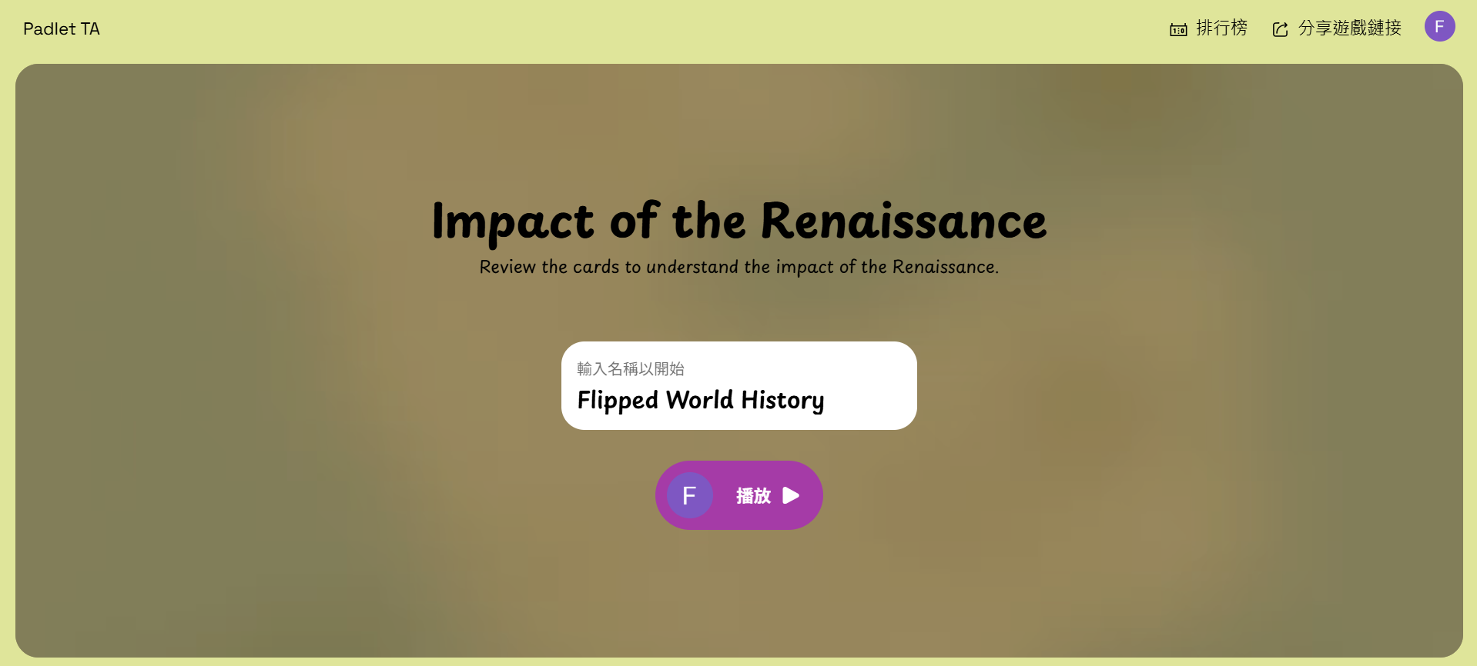

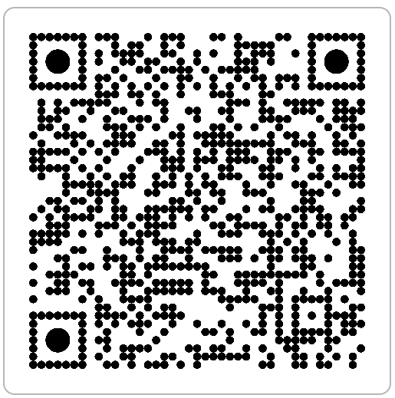

Topic 5
2A pp.20-22

